Slide 1



VTNET Cloud Team
VIETTEL MICROSERVICES ARCHITECTURE
www.viettel.com.vn

Slide 2

Session Topics
Microservice Architecture
Cloud-Native application
CI/CD
Monitoring & Observability
Case study: Viettel software development
www.viettel.com.vn

Slide 3
Microservice Architecture
www.viettel.com.vn

Slide 4
Write “Well Code” is hard
Paradigm, philosophy: OOP, SOLID, DRY, KISS, YAGNI…
Design Pattern:
MVC
Dependency Injection
Hexagonal Architecture
Auto tests: Unit, Component, Acceptance...
www.viettel.com.vn
Notes:
The monolithic architecture is considered to be a traditional way of building applications. A monolithic application is built as a single and indivisible unit. Usually, such a solution comprises a client-side user interface, a server side-application, and a database. It is unified and all the functions are managed and served in one place.
Normally, monolithic applications have one large code base and lack modularity. If developers want to update or change something, they access the same code base. So, they make changes in the whole stack at once.
Unfortunately, this simple approach has a huge limitation. Successful applications have
a habit of growing over time and eventually becoming huge. During each sprint, your
development team implements a few more user stories, which, of course, means adding
many lines of code. After a few years, your small, simple application will have grown into
a monstrous monolith. To give an extreme example, I recently spoke to a developer who
was writing a tool to analyze the dependencies between the thousands of JARs in their
multi-million lines of code (LOC) application. I’m sure it took the concerted effort of a
large number of developers over many years to create such a beast.
Once your application has become a large, complex monolith, your development
organization is probably in a world of pain. Any attempts at agile development and
delivery will flounder. One major problem is that the application is overwhelmingly
complex. It’s simply too large for any single developer to fully understand. As a result,
fixing bugs and implementing new features correctly becomes difficult and time
consuming. What’s more, this tends to be a downwards spiral. If the codebase is difficult
to understand, then changes won’t be made correctly. You will end up with a monstrous,
incomprehensible big ball of mud.
The sheer size of the application will also slow down development. The larger the
application, the longer the start-up time is. I surveyed developers about the size and
performance of their monolithic applications, and some reported start-up times as long
as 12 minutes. I’ve also heard anecdotes of applications taking as long as 40 minutes to
start up. If developers regularly have to restart the application server, then a large part
of their day will be spent waiting around and their productivity will suffer.
Another problem with a large, complex monolithic application is that it is an obstacle to
continuous deployment. Today, the state of the art for SaaS applications is to push changes
into production many times a day. This is extremely difficult to do with a complex monolith,
since you must redeploy the entire application in order to update any one part of it.
The lengthy start-up times that I mentioned earlier won’t help either. Also, since the impact
of a change is usually not very well understood, it is likely that you have to do extensive
manual testing. Consequently, continuous deployment is next to impossible to do.
Monolithic applications can also be difficult to scale when different modules have conflicting
resource requirements. For example, one module might implement CPU-intensive image
processing logic and would ideally be deployed in Amazon EC2 Compute Optimized
instances. Another module might be an in-memory database and best suited for EC2
Memory-optimized instances. However, because these modules are deployed together,
you have to compromise on the choice of hardware.
Another problem with monolithic applications is reliability. Because all modules are running
within the same process, a bug in any module, such as a memory leak, can potentially bring
down the entire process. Moreover, since all instances of the application are identical,
that bug will impact the availability of the entire application.
Last but not least, monolithic applications make it extremely difficult to adopt new
frameworks and languages. For example, let’s imagine that you have 2 million lines of code
written using the XYZ framework. It would be extremely expensive (in both time and cost)
to rewrite the entire application to use the newer ABC framework, even if that framework
was considerably better. As a result, there is a huge barrier to adopting new technologies.
You are stuck with whatever technology choices you made at the start of the project.
To summarize: you have a successful business-critical application that has grown into a
monstrous monolith that very few, if any, developers understand. It is written using obsolete,
unproductive technology that makes hiring talented developers difficult. The application is
difficult to scale and is unreliable. As a result, agile development and delivery of applications
is impossible.
Strengths of the Monolithic Architecture
Less cross-cutting concerns. Cross-cutting concerns are the concerns that affect the whole application such as logging, handling, caching, and performance monitoring. In a monolithic application, this area of functionality concerns only one application so it is easier to handle it.
Easier debugging and testing. In contrast to the microservices architecture, monolithic applications are much easier to debug and test. Since a monolithic app is a single indivisible unit, you can run end-to-end testing much faster.
Simple to deploy. Another advantage associated with the simplicity of monolithic apps is easier deployment. When it comes to monolithic applications, you do not have to handle many deployments – just one file or directory.
Simple to develop. As long as the monolithic approach is a standard way of building applications, any engineering team has the right knowledge and capabilities to develop a monolithic application.
Weaknesses of the Monolithic Architecture
Understanding. When a monolithic application scales up, it becomes too complicated to understand. Also, a complex system of code within one application is hard to manage.
Making changes. It is harder to implement changes in such a large and complex application with highly tight coupling. Any code change affects the whole system so it has to be thoroughly coordinated. This makes the overall development process much longer.
Scalability. You cannot scale components independently, only the whole application.
New technology barriers. It is extremely problematic to apply a new technology in a monolithic application because then the entire application has to be rewritten.

Slide 5
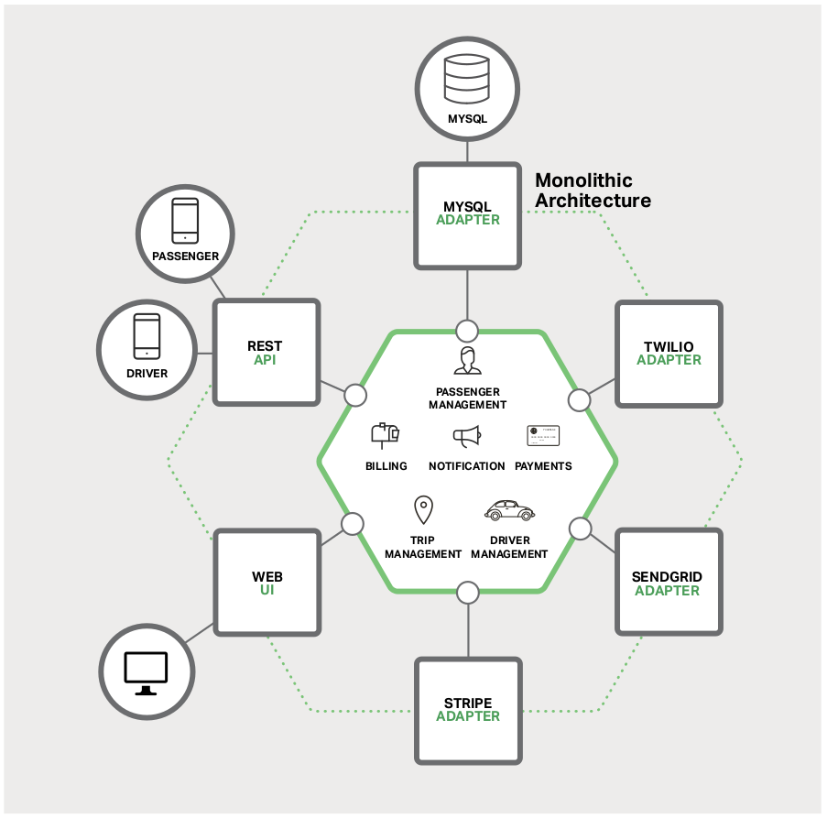
But over time, “Well Code” system growing
www.viettel.com.vn
Notes:
The monolithic architecture is considered to be a traditional way of building applications. A monolithic application is built as a single and indivisible unit. Usually, such a solution comprises a client-side user interface, a server side-application, and a database. It is unified and all the functions are managed and served in one place.
Normally, monolithic applications have one large code base and lack modularity. If developers want to update or change something, they access the same code base. So, they make changes in the whole stack at once.
Unfortunately, this simple approach has a huge limitation. Successful applications have
a habit of growing over time and eventually becoming huge. During each sprint, your
development team implements a few more user stories, which, of course, means adding
many lines of code. After a few years, your small, simple application will have grown into
a monstrous monolith. To give an extreme example, I recently spoke to a developer who
was writing a tool to analyze the dependencies between the thousands of JARs in their
multi-million lines of code (LOC) application. I’m sure it took the concerted effort of a
large number of developers over many years to create such a beast.
Once your application has become a large, complex monolith, your development
organization is probably in a world of pain. Any attempts at agile development and
delivery will flounder. One major problem is that the application is overwhelmingly
complex. It’s simply too large for any single developer to fully understand. As a result,
fixing bugs and implementing new features correctly becomes difficult and time
consuming. What’s more, this tends to be a downwards spiral. If the codebase is difficult
to understand, then changes won’t be made correctly. You will end up with a monstrous,
incomprehensible big ball of mud.
The sheer size of the application will also slow down development. The larger the
application, the longer the start-up time is. I surveyed developers about the size and
performance of their monolithic applications, and some reported start-up times as long
as 12 minutes. I’ve also heard anecdotes of applications taking as long as 40 minutes to
start up. If developers regularly have to restart the application server, then a large part
of their day will be spent waiting around and their productivity will suffer.
Another problem with a large, complex monolithic application is that it is an obstacle to
continuous deployment. Today, the state of the art for SaaS applications is to push changes
into production many times a day. This is extremely difficult to do with a complex monolith,
since you must redeploy the entire application in order to update any one part of it.
The lengthy start-up times that I mentioned earlier won’t help either. Also, since the impact
of a change is usually not very well understood, it is likely that you have to do extensive
manual testing. Consequently, continuous deployment is next to impossible to do.
Monolithic applications can also be difficult to scale when different modules have conflicting
resource requirements. For example, one module might implement CPU-intensive image
processing logic and would ideally be deployed in Amazon EC2 Compute Optimized
instances. Another module might be an in-memory database and best suited for EC2
Memory-optimized instances. However, because these modules are deployed together,
you have to compromise on the choice of hardware.
Another problem with monolithic applications is reliability. Because all modules are running
within the same process, a bug in any module, such as a memory leak, can potentially bring
down the entire process. Moreover, since all instances of the application are identical,
that bug will impact the availability of the entire application.
Last but not least, monolithic applications make it extremely difficult to adopt new
frameworks and languages. For example, let’s imagine that you have 2 million lines of code
written using the XYZ framework. It would be extremely expensive (in both time and cost)
to rewrite the entire application to use the newer ABC framework, even if that framework
was considerably better. As a result, there is a huge barrier to adopting new technologies.
You are stuck with whatever technology choices you made at the start of the project.
To summarize: you have a successful business-critical application that has grown into a
monstrous monolith that very few, if any, developers understand. It is written using obsolete,
unproductive technology that makes hiring talented developers difficult. The application is
difficult to scale and is unreliable. As a result, agile development and delivery of applications
is impossible.
Strengths of the Monolithic Architecture
Less cross-cutting concerns. Cross-cutting concerns are the concerns that affect the whole application such as logging, handling, caching, and performance monitoring. In a monolithic application, this area of functionality concerns only one application so it is easier to handle it.
Easier debugging and testing. In contrast to the microservices architecture, monolithic applications are much easier to debug and test. Since a monolithic app is a single indivisible unit, you can run end-to-end testing much faster.
Simple to deploy. Another advantage associated with the simplicity of monolithic apps is easier deployment. When it comes to monolithic applications, you do not have to handle many deployments – just one file or directory.
Simple to develop. As long as the monolithic approach is a standard way of building applications, any engineering team has the right knowledge and capabilities to develop a monolithic application.
Weaknesses of the Monolithic Architecture
Understanding. When a monolithic application scales up, it becomes too complicated to understand. Also, a complex system of code within one application is hard to manage.
Making changes. It is harder to implement changes in such a large and complex application with highly tight coupling. Any code change affects the whole system so it has to be thoroughly coordinated. This makes the overall development process much longer.
Scalability. You cannot scale components independently, only the whole application.
New technology barriers. It is extremely problematic to apply a new technology in a monolithic application because then the entire application has to be rewritten.

Slide 6
Problem when system growth
Large code base, multiple functions in one repository.
Too many dependencies need to managed.
Too many tests, need many hours to complete tests.
Hard to scale system.
Hard to adopt new technologies
Big ball of mud
www.viettel.com.vn
Notes:
The monolithic architecture is considered to be a traditional way of building applications. A monolithic application is built as a single and indivisible unit. Usually, such a solution comprises a client-side user interface, a server side-application, and a database. It is unified and all the functions are managed and served in one place.
Normally, monolithic applications have one large code base and lack modularity. If developers want to update or change something, they access the same code base. So, they make changes in the whole stack at once.
Unfortunately, this simple approach has a huge limitation. Successful applications have
a habit of growing over time and eventually becoming huge. During each sprint, your
development team implements a few more user stories, which, of course, means adding
many lines of code. After a few years, your small, simple application will have grown into
a monstrous monolith. To give an extreme example, I recently spoke to a developer who
was writing a tool to analyze the dependencies between the thousands of JARs in their
multi-million lines of code (LOC) application. I’m sure it took the concerted effort of a
large number of developers over many years to create such a beast.
Once your application has become a large, complex monolith, your development
organization is probably in a world of pain. Any attempts at agile development and
delivery will flounder. One major problem is that the application is overwhelmingly
complex. It’s simply too large for any single developer to fully understand. As a result,
fixing bugs and implementing new features correctly becomes difficult and time
consuming. What’s more, this tends to be a downwards spiral. If the codebase is difficult
to understand, then changes won’t be made correctly. You will end up with a monstrous,
incomprehensible big ball of mud.
The sheer size of the application will also slow down development. The larger the
application, the longer the start-up time is. I surveyed developers about the size and
performance of their monolithic applications, and some reported start-up times as long
as 12 minutes. I’ve also heard anecdotes of applications taking as long as 40 minutes to
start up. If developers regularly have to restart the application server, then a large part
of their day will be spent waiting around and their productivity will suffer.
Another problem with a large, complex monolithic application is that it is an obstacle to
continuous deployment. Today, the state of the art for SaaS applications is to push changes
into production many times a day. This is extremely difficult to do with a complex monolith,
since you must redeploy the entire application in order to update any one part of it.
The lengthy start-up times that I mentioned earlier won’t help either. Also, since the impact
of a change is usually not very well understood, it is likely that you have to do extensive
manual testing. Consequently, continuous deployment is next to impossible to do.
Monolithic applications can also be difficult to scale when different modules have conflicting
resource requirements. For example, one module might implement CPU-intensive image
processing logic and would ideally be deployed in Amazon EC2 Compute Optimized
instances. Another module might be an in-memory database and best suited for EC2
Memory-optimized instances. However, because these modules are deployed together,
you have to compromise on the choice of hardware.
Another problem with monolithic applications is reliability. Because all modules are running
within the same process, a bug in any module, such as a memory leak, can potentially bring
down the entire process. Moreover, since all instances of the application are identical,
that bug will impact the availability of the entire application.
Last but not least, monolithic applications make it extremely difficult to adopt new
frameworks and languages. For example, let’s imagine that you have 2 million lines of code
written using the XYZ framework. It would be extremely expensive (in both time and cost)
to rewrite the entire application to use the newer ABC framework, even if that framework
was considerably better. As a result, there is a huge barrier to adopting new technologies.
You are stuck with whatever technology choices you made at the start of the project.
To summarize: you have a successful business-critical application that has grown into a
monstrous monolith that very few, if any, developers understand. It is written using obsolete,
unproductive technology that makes hiring talented developers difficult. The application is
difficult to scale and is unreliable. As a result, agile development and delivery of applications
is impossible.
Strengths of the Monolithic Architecture
Less cross-cutting concerns. Cross-cutting concerns are the concerns that affect the whole application such as logging, handling, caching, and performance monitoring. In a monolithic application, this area of functionality concerns only one application so it is easier to handle it.
Easier debugging and testing. In contrast to the microservices architecture, monolithic applications are much easier to debug and test. Since a monolithic app is a single indivisible unit, you can run end-to-end testing much faster.
Simple to deploy. Another advantage associated with the simplicity of monolithic apps is easier deployment. When it comes to monolithic applications, you do not have to handle many deployments – just one file or directory.
Simple to develop. As long as the monolithic approach is a standard way of building applications, any engineering team has the right knowledge and capabilities to develop a monolithic application.
Weaknesses of the Monolithic Architecture
Understanding. When a monolithic application scales up, it becomes too complicated to understand. Also, a complex system of code within one application is hard to manage.
Making changes. It is harder to implement changes in such a large and complex application with highly tight coupling. Any code change affects the whole system so it has to be thoroughly coordinated. This makes the overall development process much longer.
Scalability. You cannot scale components independently, only the whole application.
New technology barriers. It is extremely problematic to apply a new technology in a monolithic application because then the entire application has to be rewritten.

Slide 7
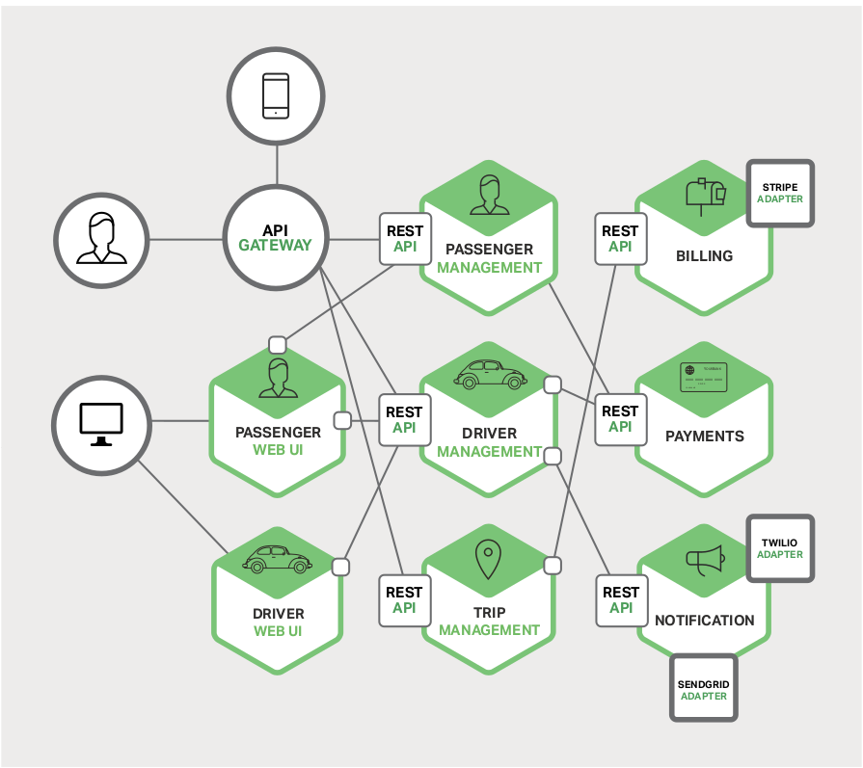
A solution for big systems: Microservice
Notes:
Microservices architecture
Many organizations, such as Amazon, eBay, and Netflix, have solved this problem by
adopting what is now known as the Microservices Architecture pattern. Instead of building
a single monstrous, monolithic application, the idea is to split your application into set of
smaller, interconnected services.
A service typically implements a set of distinct features or functionality, such as order
management, customer management, etc. Each microservice is a mini-application that has
its own hexagonal architecture consisting of business logic along with various adapters.
Some microservices would expose an API that’s consumed by other microservices or
by the application’s clients. Other microservices might implement a web UI. At runtime,
each instance is often a cloud virtual machine (VM) or a Docker container.
Each functional area of the application is now implemented by its own microservice.
Moreover, the web application is split into a set of simpler web applications – such as
one for passengers and one for drivers, in our taxi-hailing example. This makes it easier
to deploy distinct experiences for specific users, devices, or specialized use cases.
Each backend service exposes a REST API and most services consume APIs provided by
other services. For example, Driver Management uses the Notification server to tell an
available driver about a potential trip. The UI services invoke the other services in order to
render web pages. Services might also use asynchronous, message-based communication.
Inter-service communication will be covered in more detail later in this ebook.
The Microservices Architecture pattern significantly impacts the relationship between the
application and the database. Rather than sharing a single database schema with other
services, each service has its own database schema. On the one hand, this approach is
at odds with the idea of an enterprise-wide data model. Also, it often results in duplication
of some data. However, having a database schema per service is essential if you want
to benefit from microservices, because it ensures loose coupling. Figure 1-5 shows the
database architecture for the sample application.
Each of the services has its own database. Moreover, a service can use a type of database
that is best suited to its needs, the so-called polyglot persistence architecture. For example,
Driver Management, which finds drivers close to a potential passenger, must use a
database that supports efficient geo-queries
While a monolithic application is a single unified unit, a microservices architecture breaks it down into a collection of smaller independent units. These units carry out every application process as a separate service. So all the services have their own logic and the database as well as perform the specific functions.
In short, the microservice architectural style is an approach to developing a single application as a suite of small services, each running in its own process and communicating with lightweight mechanisms, often an HTTP resource API. Martin Fowler
Within a microservices architecture, the entire functionality is split up into independently deployable modules which communicate with each other through defined methods called APIs (Application Programming Interfaces). Each service covers its own scope and can be updated, deployed, and scaled independently.
Strengths of the Microservice Architecture
Independent components. Firstly, all the services can be deployed and updated independently, which gives more flexibility. Secondly, a bug in one microservice has an impact only on a particular service and does not influence the entire application. Also, it is much easier to add new features to a microservice application than a monolithic one.
Easier understanding. Split up into smaller and simpler components, a microservice application is easier to understand and manage. You just concentrate on a specific service that is related to a business goal you have.
Better scalability. Another advantage of the microservices approach is that each element can be scaled independently. So the entire process is more cost- and time-effective than with monoliths when the whole application has to be scaled even if there is no need in it. In addition, every monolith has limits in terms of scalability, so the more users you acquire, the more problems you have with your monolith. Therefore, many companies, end up rebuilding their monolithic architectures.
For instance, our partner Currencycloud needed to migrate to microservices due to the growing number of transactions their platform processed. Founded in 2012, the company offers a global B2B payments platfrom. Initially, their monolithic architecture could handle the number of transactions they had. Yet with the company’s growing success, they needed a more efficient solution they could scale even further in the future. So they have switched to microservices.
Flexibility in choosing the technology. The engineering teams are not limited by the technology chosen from the start. They are free to apply various technologies and frameworks for each microservice.
The higher level of agility. Any fault in a microservices application affects only a particular service and not the whole solution. So all the changes and experiments are implemented with lower risks and fewer errors.
Weaknesses of the Microservice Architecture
Extra complexity. Since a microservices architecture is a distributed system, you have to choose and set up the connections between all the modules and databases. Also, as long as such an application includes independent services, all of them have to be deployed independently.
System distribution. A microservices architecture is a complex system of multiple modules and databases so all the connections have to be handled carefully.
Cross-cutting concerns. When creating a microservices application, you will have to deal with a number of cross-cutting concerns. They include externalized configuration, logging, metrics, health checks, and others.
Testing. A multitude of independently deployable components makes testing a microservices-based solution much harder.

Slide 8
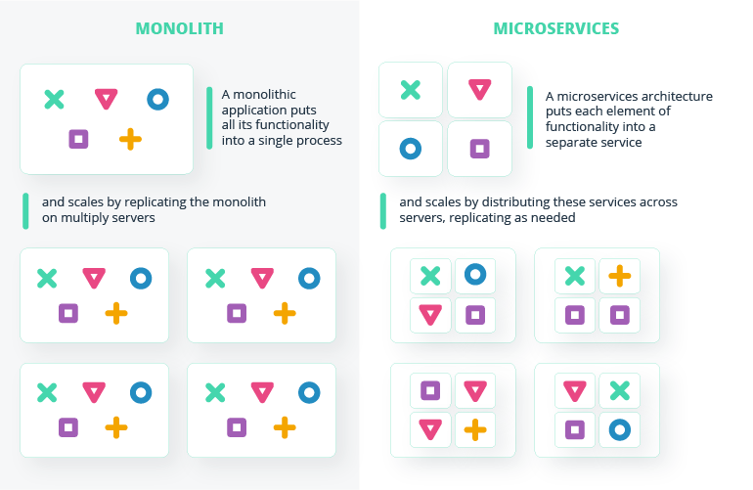
Microservice vs Monolith
Notes:
Microservices architecture
Many organizations, such as Amazon, eBay, and Netflix, have solved this problem by
adopting what is now known as the Microservices Architecture pattern. Instead of building
a single monstrous, monolithic application, the idea is to split your application into set of
smaller, interconnected services.
A service typically implements a set of distinct features or functionality, such as order
management, customer management, etc. Each microservice is a mini-application that has
its own hexagonal architecture consisting of business logic along with various adapters.
Some microservices would expose an API that’s consumed by other microservices or
by the application’s clients. Other microservices might implement a web UI. At runtime,
each instance is often a cloud virtual machine (VM) or a Docker container.
Each functional area of the application is now implemented by its own microservice.
Moreover, the web application is split into a set of simpler web applications – such as
one for passengers and one for drivers, in our taxi-hailing example. This makes it easier
to deploy distinct experiences for specific users, devices, or specialized use cases.
Each backend service exposes a REST API and most services consume APIs provided by
other services. For example, Driver Management uses the Notification server to tell an
available driver about a potential trip. The UI services invoke the other services in order to
render web pages. Services might also use asynchronous, message-based communication.
Inter-service communication will be covered in more detail later in this ebook.
The Microservices Architecture pattern significantly impacts the relationship between the
application and the database. Rather than sharing a single database schema with other
services, each service has its own database schema. On the one hand, this approach is
at odds with the idea of an enterprise-wide data model. Also, it often results in duplication
of some data. However, having a database schema per service is essential if you want
to benefit from microservices, because it ensures loose coupling. Figure 1-5 shows the
database architecture for the sample application.
Each of the services has its own database. Moreover, a service can use a type of database
that is best suited to its needs, the so-called polyglot persistence architecture. For example,
Driver Management, which finds drivers close to a potential passenger, must use a
database that supports efficient geo-queries
While a monolithic application is a single unified unit, a microservices architecture breaks it down into a collection of smaller independent units. These units carry out every application process as a separate service. So all the services have their own logic and the database as well as perform the specific functions.
In short, the microservice architectural style is an approach to developing a single application as a suite of small services, each running in its own process and communicating with lightweight mechanisms, often an HTTP resource API. Martin Fowler
Within a microservices architecture, the entire functionality is split up into independently deployable modules which communicate with each other through defined methods called APIs (Application Programming Interfaces). Each service covers its own scope and can be updated, deployed, and scaled independently.
Strengths of the Microservice Architecture
Independent components. Firstly, all the services can be deployed and updated independently, which gives more flexibility. Secondly, a bug in one microservice has an impact only on a particular service and does not influence the entire application. Also, it is much easier to add new features to a microservice application than a monolithic one.
Easier understanding. Split up into smaller and simpler components, a microservice application is easier to understand and manage. You just concentrate on a specific service that is related to a business goal you have.
Better scalability. Another advantage of the microservices approach is that each element can be scaled independently. So the entire process is more cost- and time-effective than with monoliths when the whole application has to be scaled even if there is no need in it. In addition, every monolith has limits in terms of scalability, so the more users you acquire, the more problems you have with your monolith. Therefore, many companies, end up rebuilding their monolithic architectures.
For instance, our partner Currencycloud needed to migrate to microservices due to the growing number of transactions their platform processed. Founded in 2012, the company offers a global B2B payments platfrom. Initially, their monolithic architecture could handle the number of transactions they had. Yet with the company’s growing success, they needed a more efficient solution they could scale even further in the future. So they have switched to microservices.
Flexibility in choosing the technology. The engineering teams are not limited by the technology chosen from the start. They are free to apply various technologies and frameworks for each microservice.
The higher level of agility. Any fault in a microservices application affects only a particular service and not the whole solution. So all the changes and experiments are implemented with lower risks and fewer errors.
Weaknesses of the Microservice Architecture
Extra complexity. Since a microservices architecture is a distributed system, you have to choose and set up the connections between all the modules and databases. Also, as long as such an application includes independent services, all of them have to be deployed independently.
System distribution. A microservices architecture is a complex system of multiple modules and databases so all the connections have to be handled carefully.
Cross-cutting concerns. When creating a microservices application, you will have to deal with a number of cross-cutting concerns. They include externalized configuration, logging, metrics, health checks, and others.
Testing. A multitude of independently deployable components makes testing a microservices-based solution much harder.

Slide 9
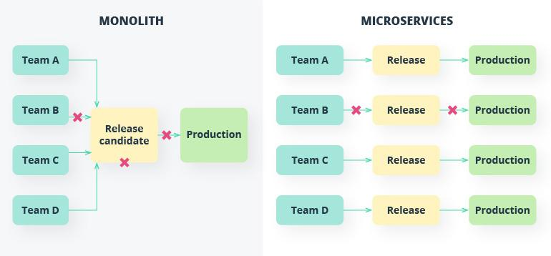
Microservice vs Monolith
Notes:
Microservices architecture
Many organizations, such as Amazon, eBay, and Netflix, have solved this problem by
adopting what is now known as the Microservices Architecture pattern. Instead of building
a single monstrous, monolithic application, the idea is to split your application into set of
smaller, interconnected services.
A service typically implements a set of distinct features or functionality, such as order
management, customer management, etc. Each microservice is a mini-application that has
its own hexagonal architecture consisting of business logic along with various adapters.
Some microservices would expose an API that’s consumed by other microservices or
by the application’s clients. Other microservices might implement a web UI. At runtime,
each instance is often a cloud virtual machine (VM) or a Docker container.
Each functional area of the application is now implemented by its own microservice.
Moreover, the web application is split into a set of simpler web applications – such as
one for passengers and one for drivers, in our taxi-hailing example. This makes it easier
to deploy distinct experiences for specific users, devices, or specialized use cases.
Each backend service exposes a REST API and most services consume APIs provided by
other services. For example, Driver Management uses the Notification server to tell an
available driver about a potential trip. The UI services invoke the other services in order to
render web pages. Services might also use asynchronous, message-based communication.
Inter-service communication will be covered in more detail later in this ebook.
The Microservices Architecture pattern significantly impacts the relationship between the
application and the database. Rather than sharing a single database schema with other
services, each service has its own database schema. On the one hand, this approach is
at odds with the idea of an enterprise-wide data model. Also, it often results in duplication
of some data. However, having a database schema per service is essential if you want
to benefit from microservices, because it ensures loose coupling. Figure 1-5 shows the
database architecture for the sample application.
Each of the services has its own database. Moreover, a service can use a type of database
that is best suited to its needs, the so-called polyglot persistence architecture. For example,
Driver Management, which finds drivers close to a potential passenger, must use a
database that supports efficient geo-queries
While a monolithic application is a single unified unit, a microservices architecture breaks it down into a collection of smaller independent units. These units carry out every application process as a separate service. So all the services have their own logic and the database as well as perform the specific functions.
In short, the microservice architectural style is an approach to developing a single application as a suite of small services, each running in its own process and communicating with lightweight mechanisms, often an HTTP resource API. Martin Fowler
Within a microservices architecture, the entire functionality is split up into independently deployable modules which communicate with each other through defined methods called APIs (Application Programming Interfaces). Each service covers its own scope and can be updated, deployed, and scaled independently.
Strengths of the Microservice Architecture
Independent components. Firstly, all the services can be deployed and updated independently, which gives more flexibility. Secondly, a bug in one microservice has an impact only on a particular service and does not influence the entire application. Also, it is much easier to add new features to a microservice application than a monolithic one.
Easier understanding. Split up into smaller and simpler components, a microservice application is easier to understand and manage. You just concentrate on a specific service that is related to a business goal you have.
Better scalability. Another advantage of the microservices approach is that each element can be scaled independently. So the entire process is more cost- and time-effective than with monoliths when the whole application has to be scaled even if there is no need in it. In addition, every monolith has limits in terms of scalability, so the more users you acquire, the more problems you have with your monolith. Therefore, many companies, end up rebuilding their monolithic architectures.
For instance, our partner Currencycloud needed to migrate to microservices due to the growing number of transactions their platform processed. Founded in 2012, the company offers a global B2B payments platfrom. Initially, their monolithic architecture could handle the number of transactions they had. Yet with the company’s growing success, they needed a more efficient solution they could scale even further in the future. So they have switched to microservices.
Flexibility in choosing the technology. The engineering teams are not limited by the technology chosen from the start. They are free to apply various technologies and frameworks for each microservice.
The higher level of agility. Any fault in a microservices application affects only a particular service and not the whole solution. So all the changes and experiments are implemented with lower risks and fewer errors.
Weaknesses of the Microservice Architecture
Extra complexity. Since a microservices architecture is a distributed system, you have to choose and set up the connections between all the modules and databases. Also, as long as such an application includes independent services, all of them have to be deployed independently.
System distribution. A microservices architecture is a complex system of multiple modules and databases so all the connections have to be handled carefully.
Cross-cutting concerns. When creating a microservices application, you will have to deal with a number of cross-cutting concerns. They include externalized configuration, logging, metrics, health checks, and others.
Testing. A multitude of independently deployable components makes testing a microservices-based solution much harder.

Slide 10
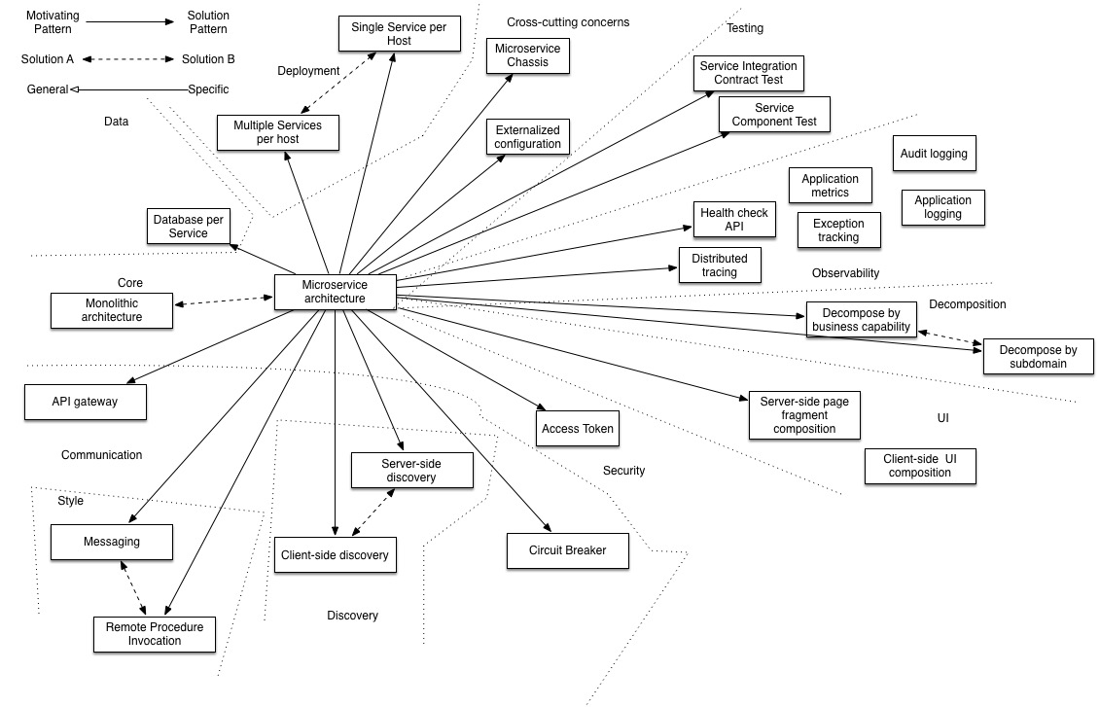
Microservice Problems And Patterns

Slide 11
Decomposition
Database Management
Communication
Deployment
Observability
Microservice Patterns
www.viettel.com.vn

Slide 12
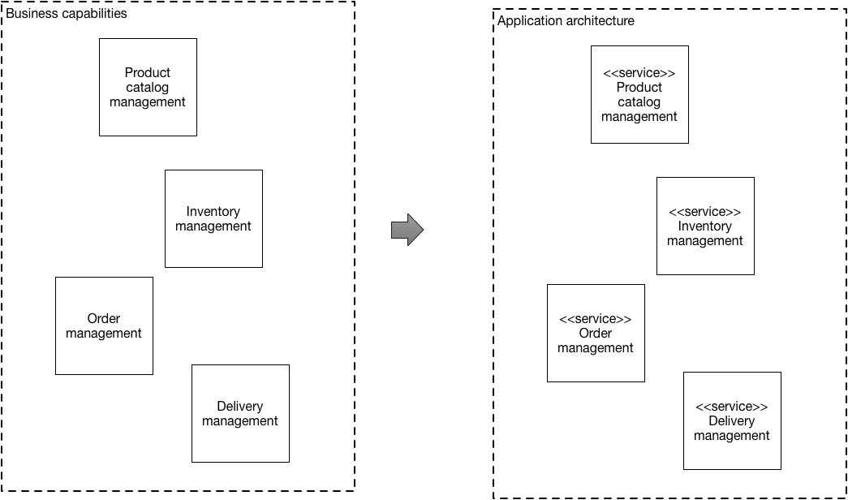
Decomposition
Decompose by business capability
www.viettel.com.vn
Notes:
Define services corresponding to business capabilities. A business capability is a concept from business architecture modeling. It is something that a business does in order to generate value. A business capability often corresponds to a business object, e.g.
Order Management is responsible for orders
Customer Management is responsible for customers
Business capabilities are often organized into a multi-level hierarchy. For example, an enterprise application might have top-level categories such as Product/Service development, Product/Service delivery, Demand generation, etc.
Examples
The business capabilities of an online store include:
Product catalog management
Inventory management
Order management
Delivery management
…
The corresponding microservice architecture would have services corresponding to each of these capabilities.
Issues
There are the following issues to address:
How to identify business capabilities? Identifying business capabilities and hence services requires an understanding of the business. An organization’s business capabilities are identified by analyzing the organization’s purpose, structure, business processes, and areas of expertise. Bounded contexts are best identified using an iterative process. Good starting points for identifying business capabilities are:
organization structure - different groups within an organization might correspond to business capabilities or business capability groups.
high-level domain model - business capabilities often correspond to domain objects
Related patterns
The Decompose by subdomain pattern is an alternative patter

Slide 13
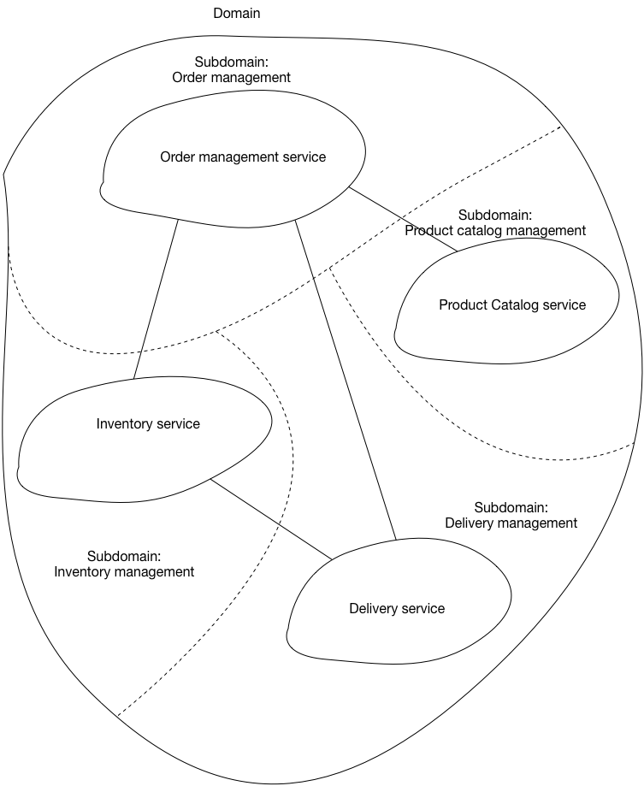
Decomposition
Decompose by subdomain
www.viettel.com.vn
Notes:
Define services corresponding to Domain-Driven Design (DDD) subdomains. DDD refers to the application’s problem space - the business - as the domain. A domain is consists of multiple subdomains. Each subdomain corresponds to a different part of the business.
Subdomains can be classified as follows:
Core - key differentiator for the business and the most valuable part of the application
Supporting - related to what the business does but not a differentiator. These can be implemented in-house or outsourced.
Generic - not specific to the business and are ideally implemented using off the shelf software
Examples
The subdomains of an online store include:
Product catalog
Inventory management
Order management
Delivery management
…
The corresponding microservice architecture would have services corresponding to each of these subdomains
This pattern has the following benefits:
Stable architecture since the subdomains are relatively stable
Development teams are cross-functional, autonomous, and organized around delivering business value rather than technical features
Services are cohesive and loosely coupled
Issues
There are the following issues to address:
How to identify the subdomains? Identifying subdomains and hence services requires an understanding of the business. Like business capabilities, subdomains are identified by analyzing the business and its organizational structure and identifying the different areas of expertise. Subdomains are best identified using an iterative process. Good starting points for identifying subdomains are:
organization structure - different groups within an organization might correspond to subdomains
high-level domain model - subdomains often have a key domain object

Slide 14
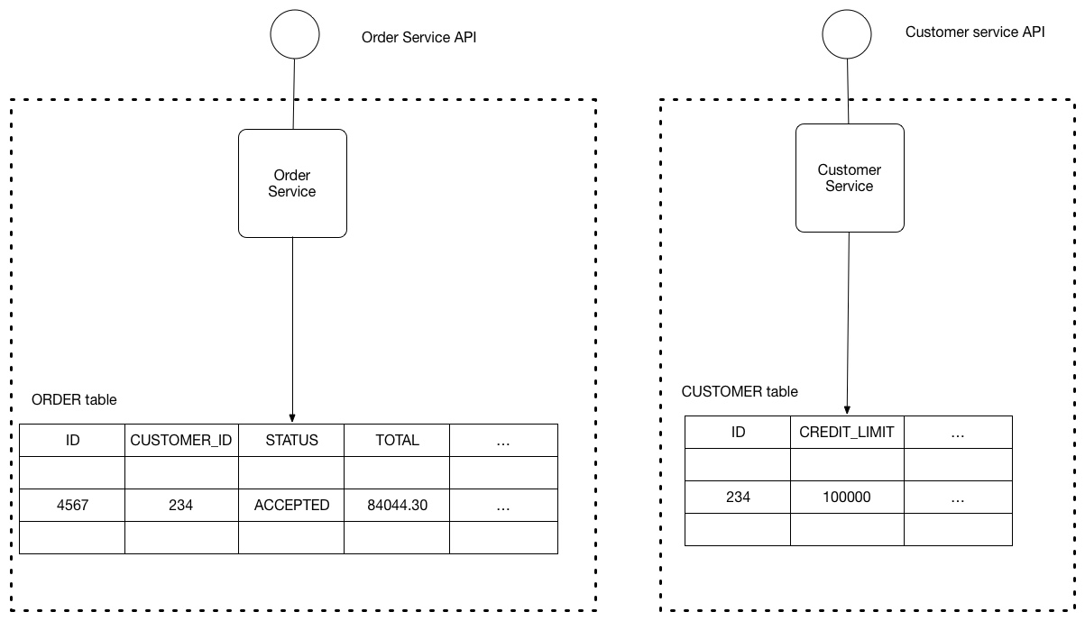
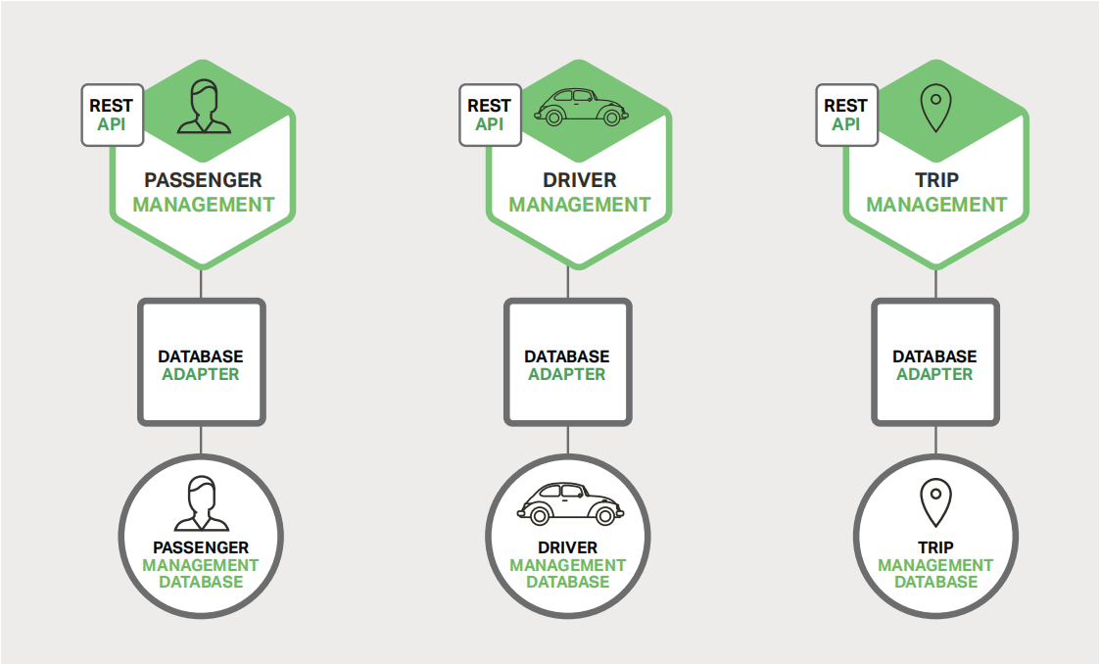
Database Management
Private-tables-per-service
Schema-per-service
Database-server-per-service
www.viettel.com.vn
Notes:
Define services corresponding to Domain-Driven Design (DDD) subdomains. DDD refers to the application’s problem space - the business - as the domain. A domain is consists of multiple subdomains. Each subdomain corresponds to a different part of the business.
Subdomains can be classified as follows:
Core - key differentiator for the business and the most valuable part of the application
Supporting - related to what the business does but not a differentiator. These can be implemented in-house or outsourced.
Generic - not specific to the business and are ideally implemented using off the shelf software
Examples
The subdomains of an online store include:
Product catalog
Inventory management
Order management
Delivery management
…
The corresponding microservice architecture would have services corresponding to each of these subdomains
This pattern has the following benefits:
Stable architecture since the subdomains are relatively stable
Development teams are cross-functional, autonomous, and organized around delivering business value rather than technical features
Services are cohesive and loosely coupled
Issues
There are the following issues to address:
How to identify the subdomains? Identifying subdomains and hence services requires an understanding of the business. Like business capabilities, subdomains are identified by analyzing the business and its organizational structure and identifying the different areas of expertise. Subdomains are best identified using an iterative process. Good starting points for identifying subdomains are:
organization structure - different groups within an organization might correspond to subdomains
high-level domain model - subdomains often have a key domain object

Slide 15
Communication
External API
API Gateway
Backend for front-end
Service-to-service communication
Hub communication
Client-side discovery
Server-side discovery
Circuit Breaker
www.viettel.com.vn
Notes:
Define services corresponding to Domain-Driven Design (DDD) subdomains. DDD refers to the application’s problem space - the business - as the domain. A domain is consists of multiple subdomains. Each subdomain corresponds to a different part of the business.
Subdomains can be classified as follows:
Core - key differentiator for the business and the most valuable part of the application
Supporting - related to what the business does but not a differentiator. These can be implemented in-house or outsourced.
Generic - not specific to the business and are ideally implemented using off the shelf software
Examples
The subdomains of an online store include:
Product catalog
Inventory management
Order management
Delivery management
…
The corresponding microservice architecture would have services corresponding to each of these subdomains
This pattern has the following benefits:
Stable architecture since the subdomains are relatively stable
Development teams are cross-functional, autonomous, and organized around delivering business value rather than technical features
Services are cohesive and loosely coupled
Issues
There are the following issues to address:
How to identify the subdomains? Identifying subdomains and hence services requires an understanding of the business. Like business capabilities, subdomains are identified by analyzing the business and its organizational structure and identifying the different areas of expertise. Subdomains are best identified using an iterative process. Good starting points for identifying subdomains are:
organization structure - different groups within an organization might correspond to subdomains
high-level domain model - subdomains often have a key domain object

Slide 16
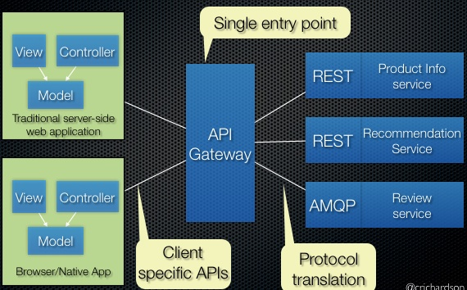
External API
API Gateway pattern
www.viettel.com.vn
Notes:
Define services corresponding to Domain-Driven Design (DDD) subdomains. DDD refers to the application’s problem space - the business - as the domain. A domain is consists of multiple subdomains. Each subdomain corresponds to a different part of the business.
Subdomains can be classified as follows:
Core - key differentiator for the business and the most valuable part of the application
Supporting - related to what the business does but not a differentiator. These can be implemented in-house or outsourced.
Generic - not specific to the business and are ideally implemented using off the shelf software
Examples
The subdomains of an online store include:
Product catalog
Inventory management
Order management
Delivery management
…
The corresponding microservice architecture would have services corresponding to each of these subdomains
This pattern has the following benefits:
Stable architecture since the subdomains are relatively stable
Development teams are cross-functional, autonomous, and organized around delivering business value rather than technical features
Services are cohesive and loosely coupled
Issues
There are the following issues to address:
How to identify the subdomains? Identifying subdomains and hence services requires an understanding of the business. Like business capabilities, subdomains are identified by analyzing the business and its organizational structure and identifying the different areas of expertise. Subdomains are best identified using an iterative process. Good starting points for identifying subdomains are:
organization structure - different groups within an organization might correspond to subdomains
high-level domain model - subdomains often have a key domain object

Slide 17
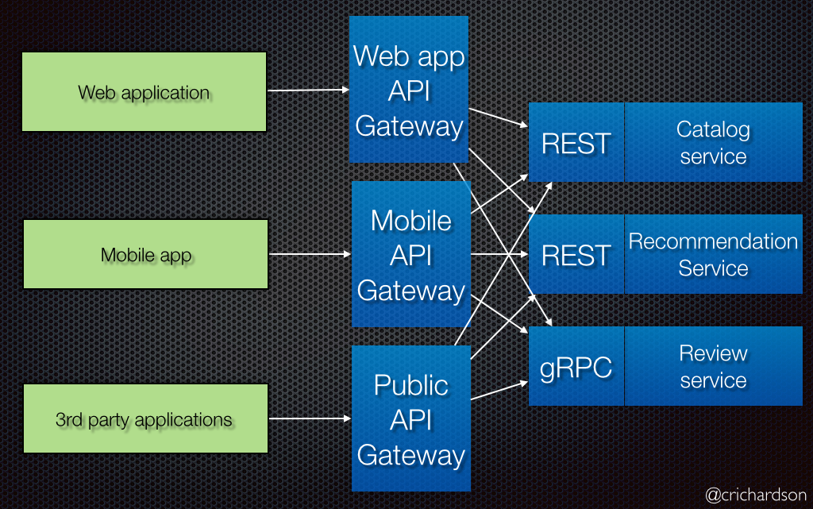
External API
Variation: Backends for frontends
www.viettel.com.vn
Notes:
Define services corresponding to Domain-Driven Design (DDD) subdomains. DDD refers to the application’s problem space - the business - as the domain. A domain is consists of multiple subdomains. Each subdomain corresponds to a different part of the business.
Subdomains can be classified as follows:
Core - key differentiator for the business and the most valuable part of the application
Supporting - related to what the business does but not a differentiator. These can be implemented in-house or outsourced.
Generic - not specific to the business and are ideally implemented using off the shelf software
Examples
The subdomains of an online store include:
Product catalog
Inventory management
Order management
Delivery management
…
The corresponding microservice architecture would have services corresponding to each of these subdomains
This pattern has the following benefits:
Stable architecture since the subdomains are relatively stable
Development teams are cross-functional, autonomous, and organized around delivering business value rather than technical features
Services are cohesive and loosely coupled
Issues
There are the following issues to address:
How to identify the subdomains? Identifying subdomains and hence services requires an understanding of the business. Like business capabilities, subdomains are identified by analyzing the business and its organizational structure and identifying the different areas of expertise. Subdomains are best identified using an iterative process. Good starting points for identifying subdomains are:
organization structure - different groups within an organization might correspond to subdomains
high-level domain model - subdomains often have a key domain object

Slide 18
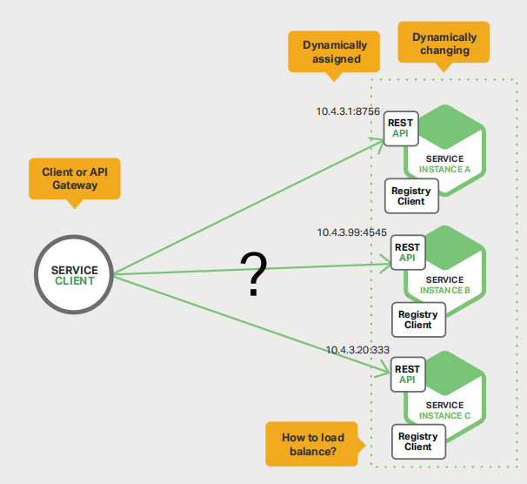
Service-to-service communication
www.viettel.com.vn
Notes:
Define services corresponding to Domain-Driven Design (DDD) subdomains. DDD refers to the application’s problem space - the business - as the domain. A domain is consists of multiple subdomains. Each subdomain corresponds to a different part of the business.
Subdomains can be classified as follows:
Core - key differentiator for the business and the most valuable part of the application
Supporting - related to what the business does but not a differentiator. These can be implemented in-house or outsourced.
Generic - not specific to the business and are ideally implemented using off the shelf software
Examples
The subdomains of an online store include:
Product catalog
Inventory management
Order management
Delivery management
…
The corresponding microservice architecture would have services corresponding to each of these subdomains
This pattern has the following benefits:
Stable architecture since the subdomains are relatively stable
Development teams are cross-functional, autonomous, and organized around delivering business value rather than technical features
Services are cohesive and loosely coupled
Issues
There are the following issues to address:
How to identify the subdomains? Identifying subdomains and hence services requires an understanding of the business. Like business capabilities, subdomains are identified by analyzing the business and its organizational structure and identifying the different areas of expertise. Subdomains are best identified using an iterative process. Good starting points for identifying subdomains are:
organization structure - different groups within an organization might correspond to subdomains
high-level domain model - subdomains often have a key domain object

Slide 19
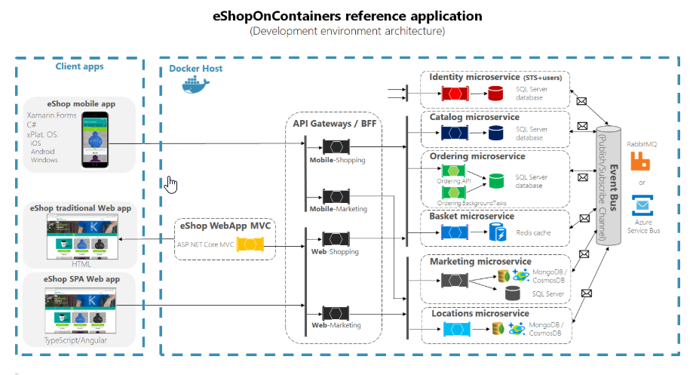
Service-to-service communication
Hub communication
www.viettel.com.vn
Notes:
Define services corresponding to Domain-Driven Design (DDD) subdomains. DDD refers to the application’s problem space - the business - as the domain. A domain is consists of multiple subdomains. Each subdomain corresponds to a different part of the business.
Subdomains can be classified as follows:
Core - key differentiator for the business and the most valuable part of the application
Supporting - related to what the business does but not a differentiator. These can be implemented in-house or outsourced.
Generic - not specific to the business and are ideally implemented using off the shelf software
Examples
The subdomains of an online store include:
Product catalog
Inventory management
Order management
Delivery management
…
The corresponding microservice architecture would have services corresponding to each of these subdomains
This pattern has the following benefits:
Stable architecture since the subdomains are relatively stable
Development teams are cross-functional, autonomous, and organized around delivering business value rather than technical features
Services are cohesive and loosely coupled
Issues
There are the following issues to address:
How to identify the subdomains? Identifying subdomains and hence services requires an understanding of the business. Like business capabilities, subdomains are identified by analyzing the business and its organizational structure and identifying the different areas of expertise. Subdomains are best identified using an iterative process. Good starting points for identifying subdomains are:
organization structure - different groups within an organization might correspond to subdomains
high-level domain model - subdomains often have a key domain object

Slide 20
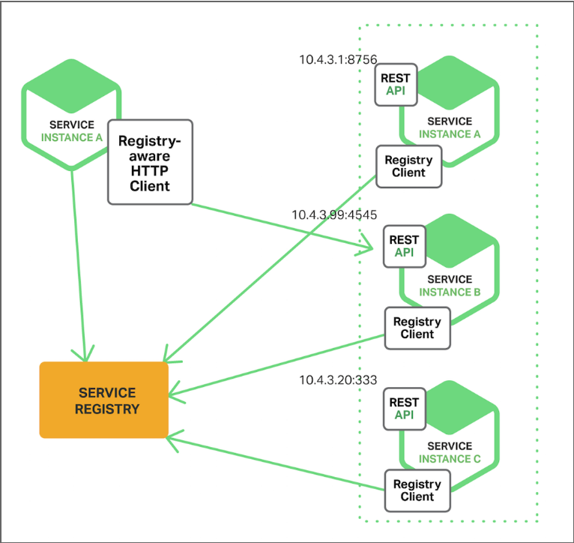
Service-to-service communication
Client-side discovery
www.viettel.com.vn
Notes:
Define services corresponding to Domain-Driven Design (DDD) subdomains. DDD refers to the application’s problem space - the business - as the domain. A domain is consists of multiple subdomains. Each subdomain corresponds to a different part of the business.
Subdomains can be classified as follows:
Core - key differentiator for the business and the most valuable part of the application
Supporting - related to what the business does but not a differentiator. These can be implemented in-house or outsourced.
Generic - not specific to the business and are ideally implemented using off the shelf software
Examples
The subdomains of an online store include:
Product catalog
Inventory management
Order management
Delivery management
…
The corresponding microservice architecture would have services corresponding to each of these subdomains
This pattern has the following benefits:
Stable architecture since the subdomains are relatively stable
Development teams are cross-functional, autonomous, and organized around delivering business value rather than technical features
Services are cohesive and loosely coupled
Issues
There are the following issues to address:
How to identify the subdomains? Identifying subdomains and hence services requires an understanding of the business. Like business capabilities, subdomains are identified by analyzing the business and its organizational structure and identifying the different areas of expertise. Subdomains are best identified using an iterative process. Good starting points for identifying subdomains are:
organization structure - different groups within an organization might correspond to subdomains
high-level domain model - subdomains often have a key domain object

Slide 21
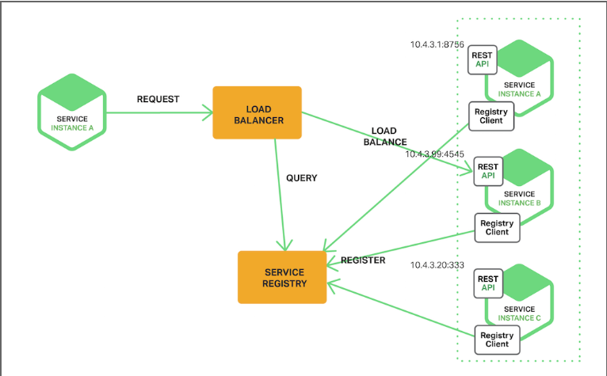
Service-to-service communication
Server-side discovery
www.viettel.com.vn
Notes:
Define services corresponding to Domain-Driven Design (DDD) subdomains. DDD refers to the application’s problem space - the business - as the domain. A domain is consists of multiple subdomains. Each subdomain corresponds to a different part of the business.
Subdomains can be classified as follows:
Core - key differentiator for the business and the most valuable part of the application
Supporting - related to what the business does but not a differentiator. These can be implemented in-house or outsourced.
Generic - not specific to the business and are ideally implemented using off the shelf software
Examples
The subdomains of an online store include:
Product catalog
Inventory management
Order management
Delivery management
…
The corresponding microservice architecture would have services corresponding to each of these subdomains
This pattern has the following benefits:
Stable architecture since the subdomains are relatively stable
Development teams are cross-functional, autonomous, and organized around delivering business value rather than technical features
Services are cohesive and loosely coupled
Issues
There are the following issues to address:
How to identify the subdomains? Identifying subdomains and hence services requires an understanding of the business. Like business capabilities, subdomains are identified by analyzing the business and its organizational structure and identifying the different areas of expertise. Subdomains are best identified using an iterative process. Good starting points for identifying subdomains are:
organization structure - different groups within an organization might correspond to subdomains
high-level domain model - subdomains often have a key domain object

Slide 22
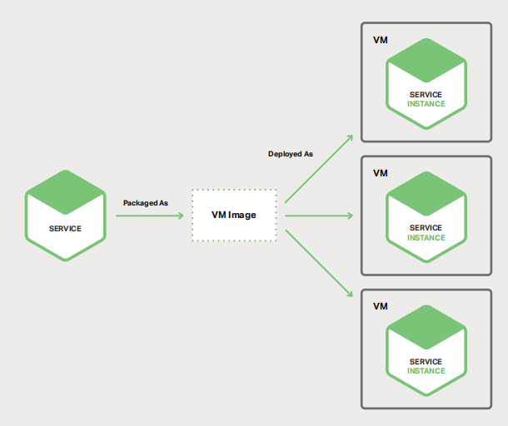
Microservice Deployment
Service Instance per Virtual Machine Pattern
www.viettel.com.vn
Notes:
Define services corresponding to Domain-Driven Design (DDD) subdomains. DDD refers to the application’s problem space - the business - as the domain. A domain is consists of multiple subdomains. Each subdomain corresponds to a different part of the business.
Subdomains can be classified as follows:
Core - key differentiator for the business and the most valuable part of the application
Supporting - related to what the business does but not a differentiator. These can be implemented in-house or outsourced.
Generic - not specific to the business and are ideally implemented using off the shelf software
Examples
The subdomains of an online store include:
Product catalog
Inventory management
Order management
Delivery management
…
The corresponding microservice architecture would have services corresponding to each of these subdomains
This pattern has the following benefits:
Stable architecture since the subdomains are relatively stable
Development teams are cross-functional, autonomous, and organized around delivering business value rather than technical features
Services are cohesive and loosely coupled
Issues
There are the following issues to address:
How to identify the subdomains? Identifying subdomains and hence services requires an understanding of the business. Like business capabilities, subdomains are identified by analyzing the business and its organizational structure and identifying the different areas of expertise. Subdomains are best identified using an iterative process. Good starting points for identifying subdomains are:
organization structure - different groups within an organization might correspond to subdomains
high-level domain model - subdomains often have a key domain object

Slide 23
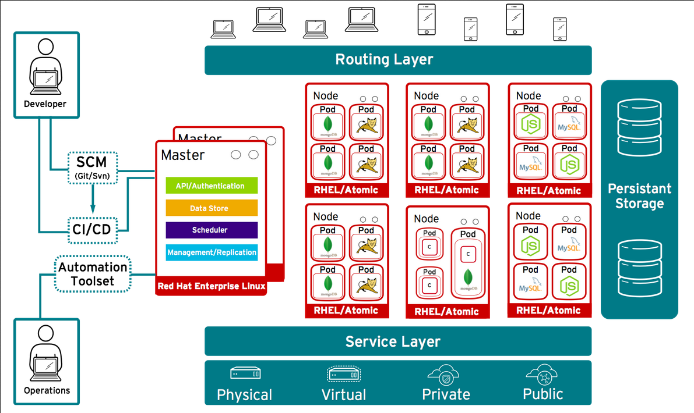
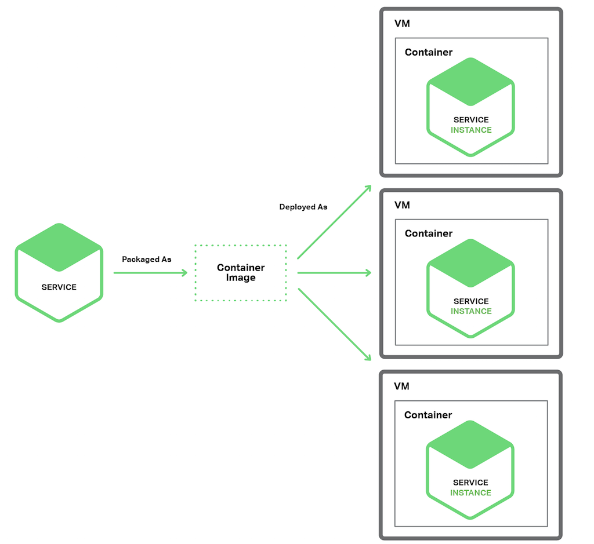
Microservice Deployment
Service Instance per Container Pattern
www.viettel.com.vn
Notes:
Define services corresponding to Domain-Driven Design (DDD) subdomains. DDD refers to the application’s problem space - the business - as the domain. A domain is consists of multiple subdomains. Each subdomain corresponds to a different part of the business.
Subdomains can be classified as follows:
Core - key differentiator for the business and the most valuable part of the application
Supporting - related to what the business does but not a differentiator. These can be implemented in-house or outsourced.
Generic - not specific to the business and are ideally implemented using off the shelf software
Examples
The subdomains of an online store include:
Product catalog
Inventory management
Order management
Delivery management
…
The corresponding microservice architecture would have services corresponding to each of these subdomains
This pattern has the following benefits:
Stable architecture since the subdomains are relatively stable
Development teams are cross-functional, autonomous, and organized around delivering business value rather than technical features
Services are cohesive and loosely coupled
Issues
There are the following issues to address:
How to identify the subdomains? Identifying subdomains and hence services requires an understanding of the business. Like business capabilities, subdomains are identified by analyzing the business and its organizational structure and identifying the different areas of expertise. Subdomains are best identified using an iterative process. Good starting points for identifying subdomains are:
organization structure - different groups within an organization might correspond to subdomains
high-level domain model - subdomains often have a key domain object

Slide 24
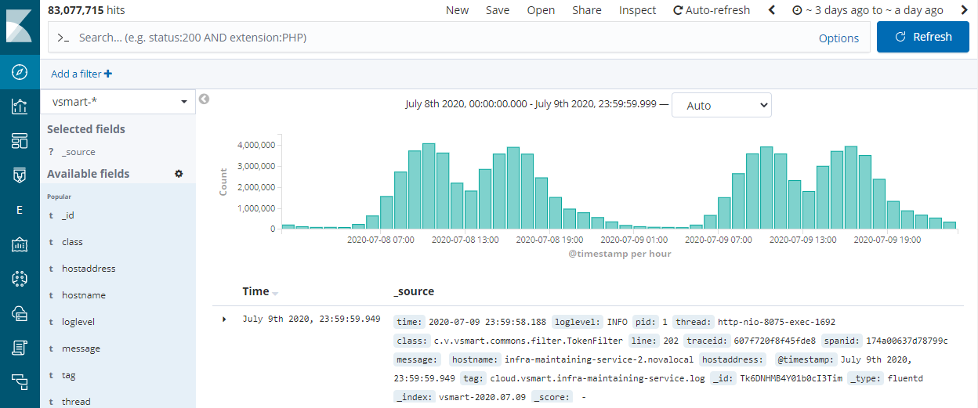
Observability
Logging
www.viettel.com.vn
Notes:
Define services corresponding to Domain-Driven Design (DDD) subdomains. DDD refers to the application’s problem space - the business - as the domain. A domain is consists of multiple subdomains. Each subdomain corresponds to a different part of the business.
Subdomains can be classified as follows:
Core - key differentiator for the business and the most valuable part of the application
Supporting - related to what the business does but not a differentiator. These can be implemented in-house or outsourced.
Generic - not specific to the business and are ideally implemented using off the shelf software
Examples
The subdomains of an online store include:
Product catalog
Inventory management
Order management
Delivery management
…
The corresponding microservice architecture would have services corresponding to each of these subdomains
This pattern has the following benefits:
Stable architecture since the subdomains are relatively stable
Development teams are cross-functional, autonomous, and organized around delivering business value rather than technical features
Services are cohesive and loosely coupled
Issues
There are the following issues to address:
How to identify the subdomains? Identifying subdomains and hence services requires an understanding of the business. Like business capabilities, subdomains are identified by analyzing the business and its organizational structure and identifying the different areas of expertise. Subdomains are best identified using an iterative process. Good starting points for identifying subdomains are:
organization structure - different groups within an organization might correspond to subdomains
high-level domain model - subdomains often have a key domain object

Slide 25
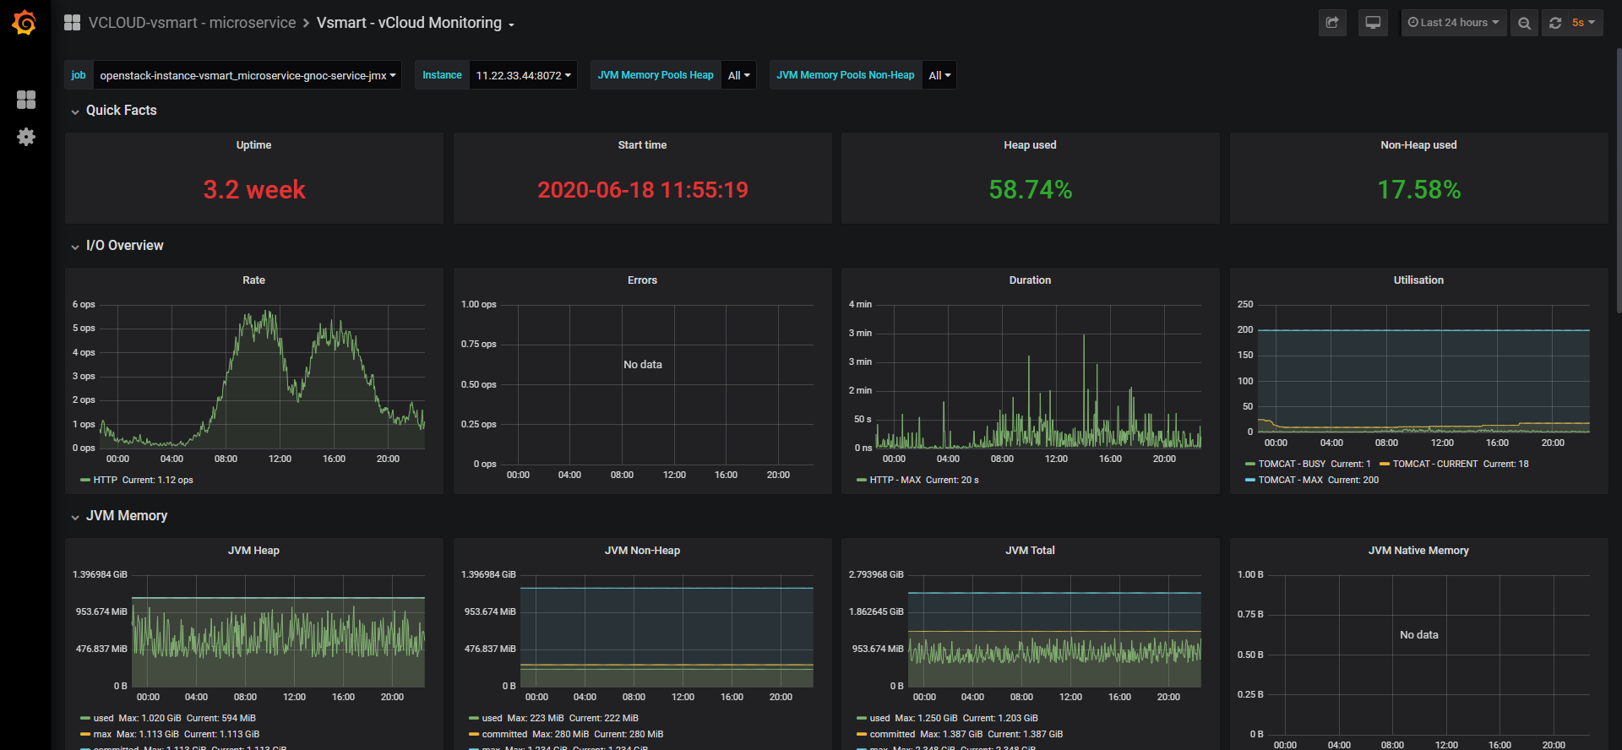
Observability
Monitoring
www.viettel.com.vn
Notes:
Define services corresponding to Domain-Driven Design (DDD) subdomains. DDD refers to the application’s problem space - the business - as the domain. A domain is consists of multiple subdomains. Each subdomain corresponds to a different part of the business.
Subdomains can be classified as follows:
Core - key differentiator for the business and the most valuable part of the application
Supporting - related to what the business does but not a differentiator. These can be implemented in-house or outsourced.
Generic - not specific to the business and are ideally implemented using off the shelf software
Examples
The subdomains of an online store include:
Product catalog
Inventory management
Order management
Delivery management
…
The corresponding microservice architecture would have services corresponding to each of these subdomains
This pattern has the following benefits:
Stable architecture since the subdomains are relatively stable
Development teams are cross-functional, autonomous, and organized around delivering business value rather than technical features
Services are cohesive and loosely coupled
Issues
There are the following issues to address:
How to identify the subdomains? Identifying subdomains and hence services requires an understanding of the business. Like business capabilities, subdomains are identified by analyzing the business and its organizational structure and identifying the different areas of expertise. Subdomains are best identified using an iterative process. Good starting points for identifying subdomains are:
organization structure - different groups within an organization might correspond to subdomains
high-level domain model - subdomains often have a key domain object

Slide 26
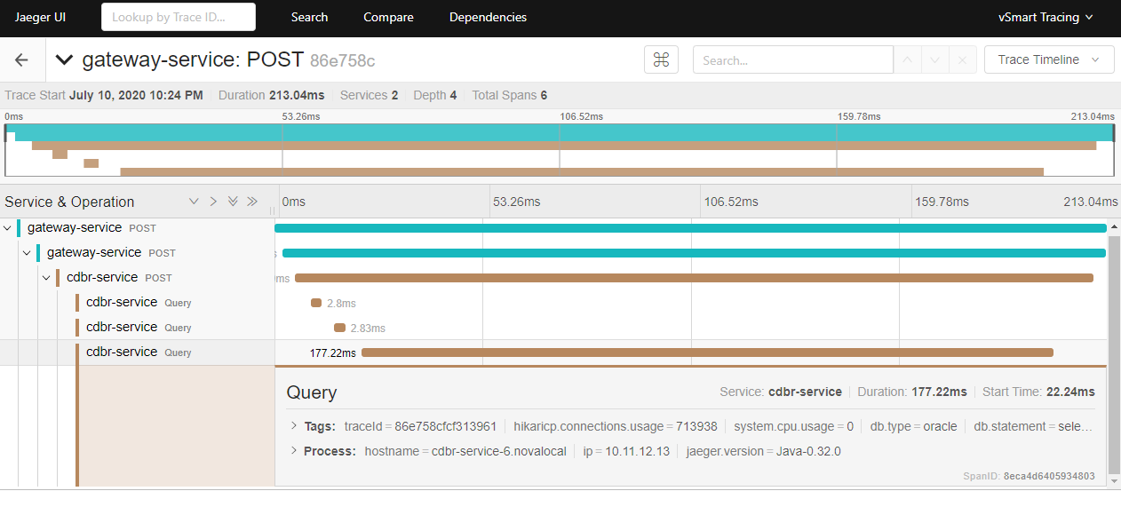
Observability
Tracing
www.viettel.com.vn
Notes:
Define services corresponding to Domain-Driven Design (DDD) subdomains. DDD refers to the application’s problem space - the business - as the domain. A domain is consists of multiple subdomains. Each subdomain corresponds to a different part of the business.
Subdomains can be classified as follows:
Core - key differentiator for the business and the most valuable part of the application
Supporting - related to what the business does but not a differentiator. These can be implemented in-house or outsourced.
Generic - not specific to the business and are ideally implemented using off the shelf software
Examples
The subdomains of an online store include:
Product catalog
Inventory management
Order management
Delivery management
…
The corresponding microservice architecture would have services corresponding to each of these subdomains
This pattern has the following benefits:
Stable architecture since the subdomains are relatively stable
Development teams are cross-functional, autonomous, and organized around delivering business value rather than technical features
Services are cohesive and loosely coupled
Issues
There are the following issues to address:
How to identify the subdomains? Identifying subdomains and hence services requires an understanding of the business. Like business capabilities, subdomains are identified by analyzing the business and its organizational structure and identifying the different areas of expertise. Subdomains are best identified using an iterative process. Good starting points for identifying subdomains are:
organization structure - different groups within an organization might correspond to subdomains
high-level domain model - subdomains often have a key domain object

Slide 27
Microservices Anti-Patterns
www.viettel.com.vn

Slide 28
Microservices Anti-Patterns
Trying to fly before you can walk
Scattershot adoption
Distributed monolith
Focussing on Technology
No API semantic versioning
Shared Libraries
Mesh dependencies
www.viettel.com.vn
Notes:
Microservices are a magic pixie dust - believing that a sprinkle of microservices will solve all of your development problems
Microservices as the goal - making the adoption of microservices the goal and measuring success in terms of the number of services written
Scattershot adoption - multiple application development teams attempt to adopt the microservice architecture without any coordination
Trying to fly before you can walk - attempting to adopt the microservice architecture (an advanced technique) without (or not committing to) practicing basic software development techniques, such as clean code, good design, and automated testing
Focussing on Technology - focussing on technology aspects of microservices, most commonly the deployment infrastructure, and neglecting key issues, such as service decomposition
More the merrier - intentionally creating a very fine-grained microservice architecture
Red Flag Law - retaining the same development process and organization structure that were used when developing monolithic applications.

Slide 29
How to avoid them?
Learn to write good monolith before go microservices
Clear design, single responsible separation
Teams coordination and governance
Devops, CI/CD cultural
www.viettel.com.vn
Notes:
Microservices are a magic pixie dust - believing that a sprinkle of microservices will solve all of your development problems
Microservices as the goal - making the adoption of microservices the goal and measuring success in terms of the number of services written
Scattershot adoption - multiple application development teams attempt to adopt the microservice architecture without any coordination
Trying to fly before you can walk - attempting to adopt the microservice architecture (an advanced technique) without (or not committing to) practicing basic software development techniques, such as clean code, good design, and automated testing
Focussing on Technology - focussing on technology aspects of microservices, most commonly the deployment infrastructure, and neglecting key issues, such as service decomposition
More the merrier - intentionally creating a very fine-grained microservice architecture
Red Flag Law - retaining the same development process and organization structure that were used when developing monolithic applications.

Slide 30
Introduction
Characteris
Benefits
12-factors application methodology
Cloud-Native Application
www.viettel.com.vn

Slide 31
Cloud-Native - Definition
An approach in software development, to:
“build and run scalable applications in modern, dynamic environments such as public, private, and hybrid clouds”
https://github.com/cncf/toc/blob/main/DEFINITION.md
www.viettel.com.vn
Notes:
Stop what you're doing and text ten of your colleagues. Ask them to define the term "Cloud Native". Good chance you'll get ten different answers.
Cloud native is all about changing the way you think about constructing critical business systems.
Cloud-native systems are designed to embrace rapid change, large scale, and resilience.
The Cloud Native Computing Foundation provides an official definition:
Cloud-native technologies empower organizations to build and run scalable applications in modern, dynamic environments such as public, private, and hybrid clouds. Containers, service meshes, microservices, immutable infrastructure, and declarative APIs exemplify this approach.
These techniques enable loosely coupled systems that are resilient, manageable, and observable. Combined with robust automation, they allow engineers to make high-impact changes frequently and predictably with minimal toil.
Applications have become increasingly complex with users demanding more and more. Users expect rapid responsiveness, innovative features, and zero downtime. Performance problems, recurring errors, and the inability to move fast are no longer acceptable. They'll easily move to your competitor.
Cloud native is about speed and agility. Business systems are evolving from enabling business capabilities to being weapons of strategic transformation that accelerate business velocity and growth. It's imperative to get ideas to market immediately.

Slide 32
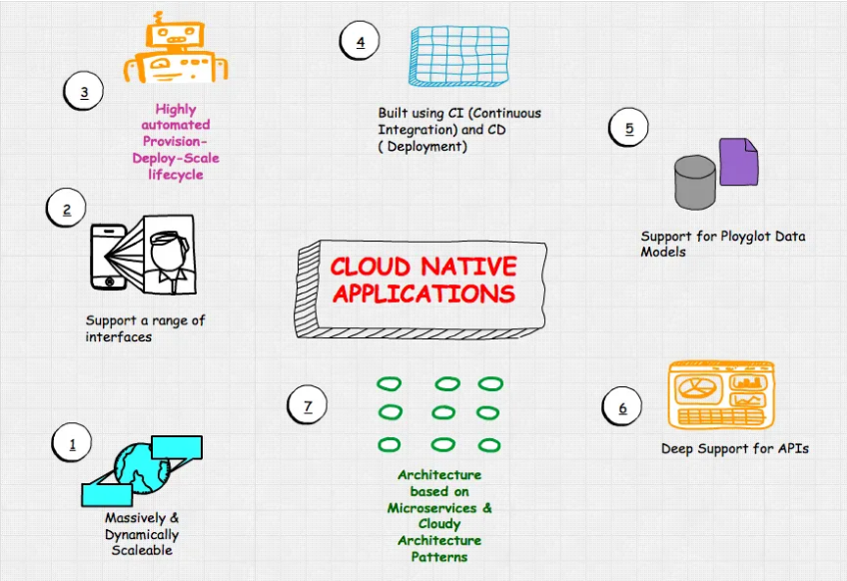
Cloud-Native - Application Characteris
www.viettel.com.vn
Notes:
The cloud-native concept was first put forward by Matt Stine at Pivotal in 2013. In 2015 when cloud-native was just becoming popular, Matt Stine defined several characteristics of cloud-native architectures in the book Migrating to Cloud-Native Application Architectures: 12-factor applications, microservices, self-service agile infrastructure, API-based collaboration, and anti-fragility. At an InfoQ interview in 2017, Matt Stine made some changes and indicated six characteristics of cloud-native architectures: modularity, observability, deployability, testability, replaceability, and handleability. The latest description about cloud-native architectures on the official Pivotal website shows four key characteristics: DevOps, continuous delivery, microservices, and containers.
In 2015, the Cloud Native Computing Foundation (CNCF) was founded. CNCF originally defined four characteristics of cloud-native architectures: containerized encapsulation, automated management, and microservices. In 2018, CNCF updated the definition of cloud-native architectures with two new features: service meshes and declarative APIs.
As we can see, different individuals and organizations have different definitions for cloud-native architectures, and even the same individual or organization has different definitions for cloud-native architectures at different points in time. This complexity makes it hard for me to clearly understand cloud-native architectures. After a while, I came up with a simple solution: to choose only one definition that is easy to remember and understand (in my case, DevOps, continuous delivery, microservices, and containers).
In a word, cloud-native applications are required to meet the following: Implement containerization by using open-source stacks like K8s and Docker, improve flexibility and maintainability based on microservices architectures, adopt agile methods, allow DevOps to support continuous iteration and automated O&M, and implement elastic scaling, dynamic scheduling, and efficient resource usage optimization by using cloud platform facilities.
Cloud-native supports simple and fast application building, easy deployment, and allows applications to be scaled as needed. Cloud-native architectures bring many advantages over traditional web frameworks and IT models and have almost no disadvantages. Cloud-native architectures are a powerful secret weapon in this industry.

Slide 33
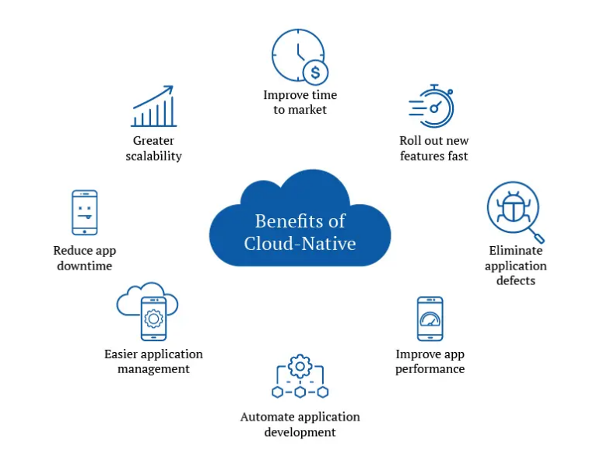
Cloud-Native - Benefits
www.viettel.com.vn
Notes:
Define services corresponding to Domain-Driven Design (DDD) subdomains. DDD refers to the application’s problem space - the business - as the domain. A domain is consists of multiple subdomains. Each subdomain corresponds to a different part of the business.
Subdomains can be classified as follows:
Core - key differentiator for the business and the most valuable part of the application
Supporting - related to what the business does but not a differentiator. These can be implemented in-house or outsourced.
Generic - not specific to the business and are ideally implemented using off the shelf software
Examples
The subdomains of an online store include:
Product catalog
Inventory management
Order management
Delivery management
…
The corresponding microservice architecture would have services corresponding to each of these subdomains
This pattern has the following benefits:
Stable architecture since the subdomains are relatively stable
Development teams are cross-functional, autonomous, and organized around delivering business value rather than technical features
Services are cohesive and loosely coupled
Issues
There are the following issues to address:
How to identify the subdomains? Identifying subdomains and hence services requires an understanding of the business. Like business capabilities, subdomains are identified by analyzing the business and its organizational structure and identifying the different areas of expertise. Subdomains are best identified using an iterative process. Good starting points for identifying subdomains are:
organization structure - different groups within an organization might correspond to subdomains
high-level domain model - subdomains often have a key domain object

Slide 34
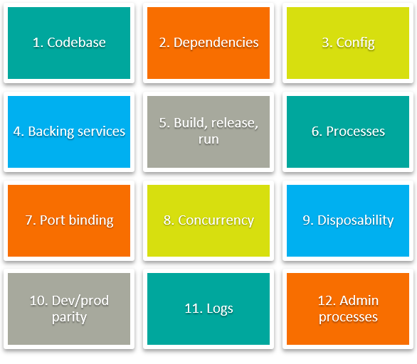
Cloud-Native - Methodology: 12 Factors
www.viettel.com.vn
Notes:
The problem was that most people simply had no idea how to build applications in a way that was “cloud friendly.” As I will discuss throughout this book, cloud-friendly applications don’t just run in the cloud; they embrace elastic scalability, ephemeral filesystems, statelessness, and treating everything as a service. Applications built this way can scale and deploy rapidly, allowing their development teams to add new features and react quickly to market changes.
Many of the cloud anti-patterns still being made today will be discussed throughout this book. Early adopters didn’t know what you could and could not do with clouds, nor did they know the design and architecture considerations that went into building an application destined for the cloud. This was a new breed of application, one for which few people had a frame of reference.
To solve this problem (and to increase their own platform adoption), a group of people within Heroku developed the 12 Factors in 2012. This is essentially a manifesto describing the rules and guidelines that needed to be followed to build a cloud native application. The goal of these 12 factors was to teach developers how to build cloud-ready applications that had declarative formats for automation and setup, had a clean contract with the underlying operating system, and were dynamically scalable.
These 12 factors were used as guidelines to help steer development of new applications, as well as to create a scorecard with which to measure existing applications and their suitability for the cloud:
Codebase: One codebase tracked in revision control, many deploys
Dependencies: Explicitly declare and isolate dependencies
Configuration: Store configuration in the environment
Backing Services: Treat backing services as attached resources
Build, release, run: Strictly separate build and run stages
Processes: Execute the app as one or more stateless processes
Port binding: Export services via port binding
Concurrency: Scale out via the process model
Disposability: Maximize robustness with fast startup and graceful shutdown
Dev/prod parity: Keep development, staging, and production as similar as possible
Logs: Treat logs as event streams
Admin processes: Run admin/management tasks as one-off processes

Slide 35
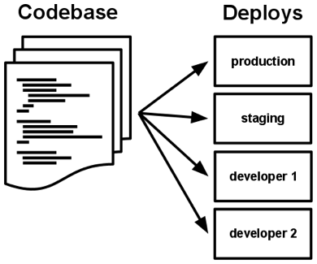
1
Codebase
One codebase tracked in revision control, many deploys
www.viettel.com.vn
Notes:
A twelve-factor app is always tracked in a version control system, such as Git, Mercurial, or Subversion. A copy of the revision tracking database is known as a code repository, often shortened to code repo or just repo.
A codebase is any single repo (in a centralized revision control system like Subversion), or any set of repos who share a root commit (in a decentralized revision control system like Git).
One codebase maps to many deploys
There is always a one-to-one correlation between the codebase and the app:
If there are multiple codebases, it’s not an app – it’s a distributed system. Each component in a distributed system is an app, and each can individually comply with twelve-factor.
Multiple apps sharing the same code is a violation of twelve-factor. The solution here is to factor shared code into libraries which can be included through the dependency manager.
There is only one codebase per app, but there will be many deploys of the app. A deploy is a running instance of the app. This is typically a production site, and one or more staging sites. Additionally, every developer has a copy of the app running in their local development environment, each of which also qualifies as a deploy.
The codebase is the same across all deploys, although different versions may be active in each deploy. For example, a developer has some commits not yet deployed to staging; staging has some commits not yet deployed to production. But they all share the same codebase, thus making them identifiable as different deploys of the same app.

Slide 36
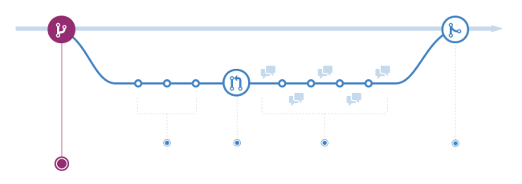
GitHub flow

Slide 37
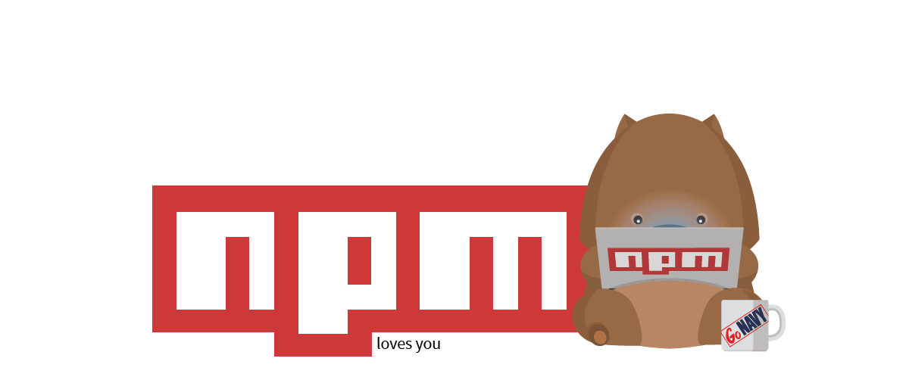
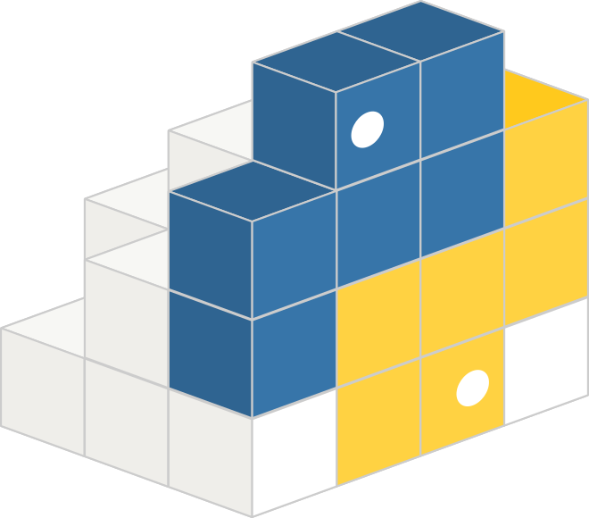

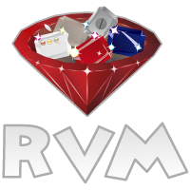

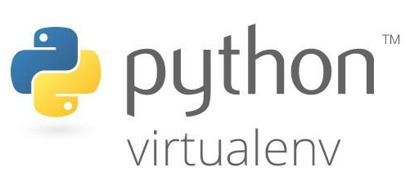
2
Dependencies
Explicitly declare and isolate dependencies
www.viettel.com.vn
Notes:
Explicitly declare and isolate dependencies
Most programming languages offer a packaging system for distributing support libraries, such as CPAN for Perl or Rubygems for Ruby. Libraries installed through a packaging system can be installed system-wide (known as “site packages”) or scoped into the directory containing the app (known as “vendoring” or “bundling”).
A twelve-factor app never relies on implicit existence of system-wide packages. It declares all dependencies, completely and exactly, via a dependency declaration manifest. Furthermore, it uses a dependency isolation tool during execution to ensure that no implicit dependencies “leak in” from the surrounding system. The full and explicit dependency specification is applied uniformly to both production and development.
For example, Bundler for Ruby offers the Gemfile manifest format for dependency declaration and bundle exec for dependency isolation. In Python there are two separate tools for these steps – Pip is used for declaration and Virtualenv for isolation. Even C has Autoconf for dependency declaration, and static linking can provide dependency isolation. No matter what the toolchain, dependency declaration and isolation must always be used together – only one or the other is not sufficient to satisfy twelve-factor.
One benefit of explicit dependency declaration is that it simplifies setup for developers new to the app. The new developer can check out the app’s codebase onto their development machine, requiring only the language runtime and dependency manager installed as prerequisites. They will be able to set up everything needed to run the app’s code with a deterministic build command. For example, the build command for Ruby/Bundler is bundle install, while for Clojure/Leiningen it is lein deps.
Twelve-factor apps also do not rely on the implicit existence of any system tools. Examples include shelling out to ImageMagick or curl. While these tools may exist on many or even most systems, there is no guarantee that they will exist on all systems where the app may run in the future, or whether the version found on a future system will be compatible with the app. If the app needs to shell out to a system tool, that tool should be vendored into the app.

Slide 38
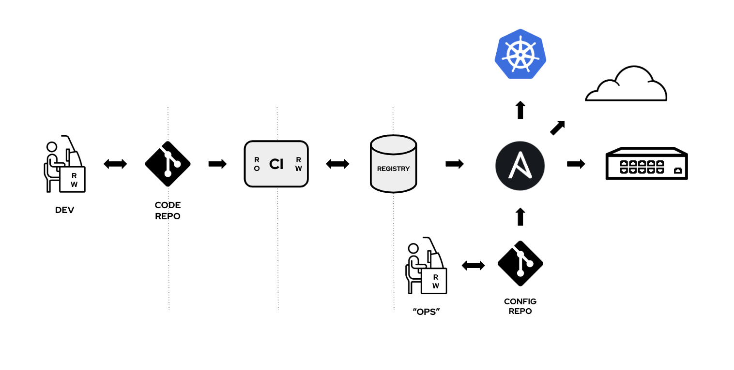
3
Config
Store config in the environment
www.viettel.com.vn
Notes:
An app’s config is everything that is likely to vary between deploys (staging, production, developer environments, etc). This includes:
Resource handles to the database, Memcached, and other backing services
Credentials to external services such as Amazon S3 or Twitter
Per-deploy values such as the canonical hostname for the deploy
Apps sometimes store config as constants in the code. This is a violation of twelve-factor, which requires strict separation of config from code. Config varies substantially across deploys, code does not.
A litmus test for whether an app has all config correctly factored out of the code is whether the codebase could be made open source at any moment, without compromising any credentials.
Note that this definition of “config” does not include internal application config, such as config/routes.rb in Rails, or how code modules are connected in Spring. This type of config does not vary between deploys, and so is best done in the code.
Another approach to config is the use of config files which are not checked into revision control, such as config/database.yml in Rails. This is a huge improvement over using constants which are checked into the code repo, but still has weaknesses: it’s easy to mistakenly check in a config file to the repo; there is a tendency for config files to be scattered about in different places and different formats, making it hard to see and manage all the config in one place. Further, these formats tend to be language- or framework-specific.
The twelve-factor app stores config in environment variables (often shortened to env vars or env). Env vars are easy to change between deploys without changing any code; unlike config files, there is little chance of them being checked into the code repo accidentally; and unlike custom config files, or other config mechanisms such as Java System Properties, they are a language- and OS-agnostic standard.
Another aspect of config management is grouping. Sometimes apps batch config into named groups (often called “environments”) named after specific deploys, such as the development, test, and production environments in Rails. This method does not scale cleanly: as more deploys of the app are created, new environment names are necessary, such as staging or qa. As the project grows further, developers may add their own special environments like joes-staging, resulting in a combinatorial explosion of config which makes managing deploys of the app very brittle.
In a twelve-factor app, env vars are granular controls, each fully orthogonal to other env vars. They are never grouped together as “environments”, but instead are independently managed for each deploy. This is a model that scales up smoothly as the app naturally expands into more deploys over its lifetime.

Slide 39
In java source code (a lot):
service = new VsaadminServiceService(url,
new QName("http://service.vsaadmin.viettel.com/", "VsaadminServiceService")
);
In xml file (a lot):
<property name="hibernate.connection.url">jdbc:oracle:thin:@11.22.33.44:1234:PM1</property>
<property name="hibernate.connection.username">qlctkt</property>
<property name="hibernate.connection.password">qlctkt@superpassw0rd</property>
Username and password were check-in VCS many times
Traditional application config styles

Slide 40
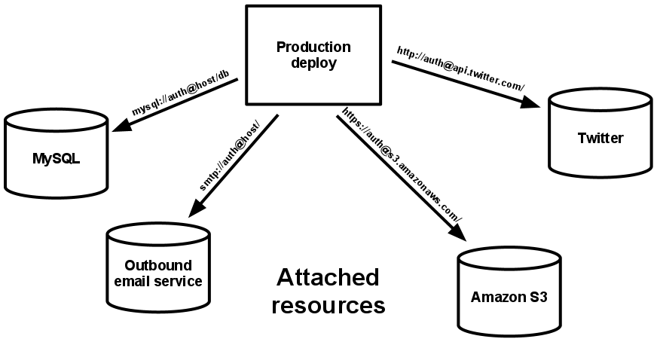
4
Backing services
Treat backing services as attached resources
www.viettel.com.vn
Notes:
A backing service is any service the app consumes over the network as part of its normal operation. Examples include datastores (such as MySQL or CouchDB), messaging/queueing systems (such as RabbitMQ or Beanstalkd), SMTP services for outbound email (such as Postfix), and caching systems (such as Memcached).
Backing services like the database are traditionally managed by the same systems administrators who deploy the app’s runtime. In addition to these locally-managed services, the app may also have services provided and managed by third parties. Examples include SMTP services (such as Postmark), metrics-gathering services (such as New Relic or Loggly), binary asset services (such as Amazon S3), and even API-accessible consumer services (such as Twitter, Google Maps, or Last.fm).
The code for a twelve-factor app makes no distinction between local and third party services. To the app, both are attached resources, accessed via a URL or other locator/credentials stored in the config. A deploy of the twelve-factor app should be able to swap out a local MySQL database with one managed by a third party (such as Amazon RDS) without any changes to the app’s code. Likewise, a local SMTP server could be swapped with a third-party SMTP service (such as Postmark) without code changes. In both cases, only the resource handle in the config needs to change.
Each distinct backing service is a resource. For example, a MySQL database is a resource; two MySQL databases (used for sharding at the application layer) qualify as two distinct resources. The twelve-factor app treats these databases as attached resources, which indicates their loose coupling to the deploy they are attached to.

Slide 41
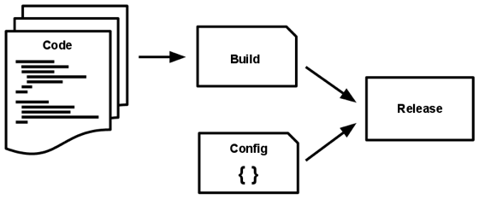
5
Build, release, run
Strictly separate build
and run stages
www.viettel.com.vn
Notes:
A codebase is transformed into a (non-development) deploy through three stages:
The build stage is a transform which converts a code repo into an executable bundle known as a build. Using a version of the code at a commit specified by the deployment process, the build stage fetches vendors dependencies and compiles binaries and assets.
The release stage takes the build produced by the build stage and combines it with the deploy’s current config. The resulting release contains both the build and the config and is ready for immediate execution in the execution environment.
The run stage (also known as “runtime”) runs the app in the execution environment, by launching some set of the app’s processes against a selected release.
Code becomes a build, which is combined with config to create a release.
The twelve-factor app uses strict separation between the build, release, and run stages. For example, it is impossible to make changes to the code at runtime, since there is no way to propagate those changes back to the build stage.
Deployment tools typically offer release management tools, most notably the ability to roll back to a previous release. For example, the Capistrano deployment tool stores releases in a subdirectory named releases, where the current release is a symlink to the current release directory. Its rollback command makes it easy to quickly roll back to a previous release.

Slide 42
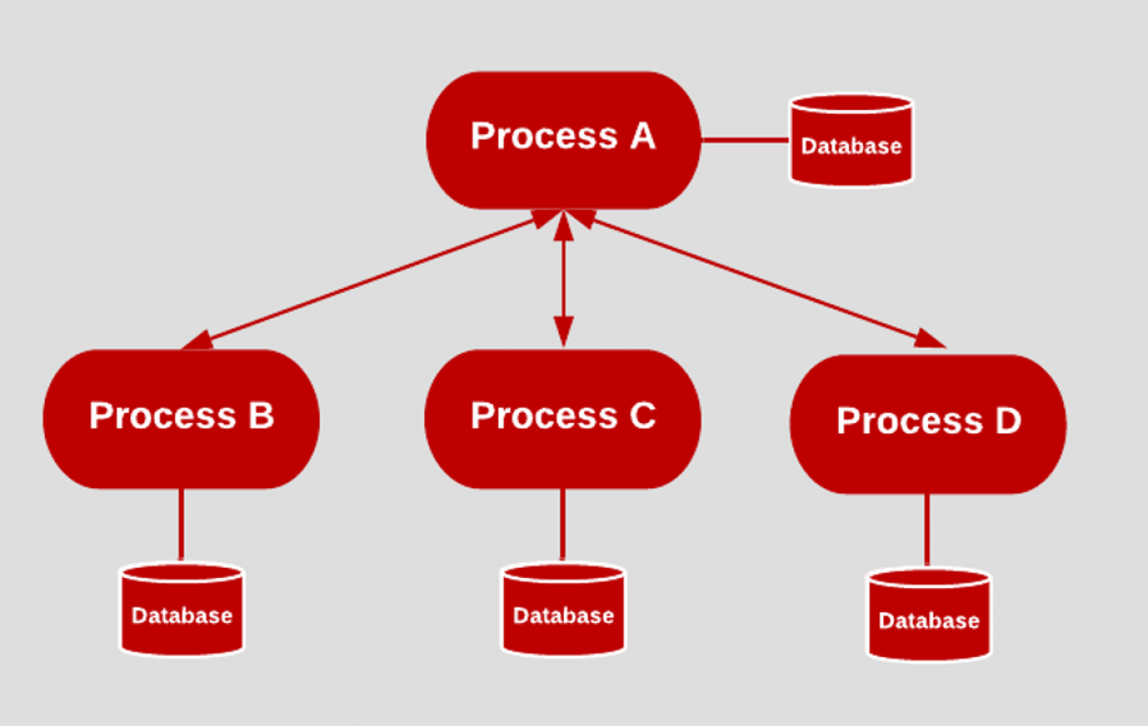
Stateless & shared-nothing
Persistent data is stored in stateful backing services
6
Processes
Execute the app as one or more stateless processes
www.viettel.com.vn
Notes:
A codebase is transformed into a (non-development) deploy through three stages:
The build stage is a transform which converts a code repo into an executable bundle known as a build. Using a version of the code at a commit specified by the deployment process, the build stage fetches vendors dependencies and compiles binaries and assets.
The release stage takes the build produced by the build stage and combines it with the deploy’s current config. The resulting release contains both the build and the config and is ready for immediate execution in the execution environment.
The run stage (also known as “runtime”) runs the app in the execution environment, by launching some set of the app’s processes against a selected release.
Code becomes a build, which is combined with config to create a release.
The twelve-factor app uses strict separation between the build, release, and run stages. For example, it is impossible to make changes to the code at runtime, since there is no way to propagate those changes back to the build stage.
Deployment tools typically offer release management tools, most notably the ability to roll back to a previous release. For example, the Capistrano deployment tool stores releases in a subdirectory named releases, where the current release is a symlink to the current release directory. Its rollback command makes it easy to quickly roll back to a previous release.

Slide 43
Self-contained
Expose URI
One app can become the backing service for another app
7
Port binding
Export services via port binding
www.viettel.com.vn
Notes:
Web apps are sometimes executed inside a webserver container. For example, PHP apps might run as a module inside Apache HTTPD, or Java apps might run inside Tomcat.
The twelve-factor app is completely self-contained and does not rely on runtime injection of a webserver into the execution environment to create a web-facing service. The web app exports HTTP as a service by binding to a port, and listening to requests coming in on that port.
In a local development environment, the developer visits a service URL like http://localhost:5000/ to access the service exported by their app. In deployment, a routing layer handles routing requests from a public-facing hostname to the port-bound web processes.
This is typically implemented by using dependency declaration to add a webserver library to the app, such as Tornado for Python, Thin for Ruby, or Jetty for Java and other JVM-based languages. This happens entirely in user space, that is, within the app’s code. The contract with the execution environment is binding to a port to serve requests.
HTTP is not the only service that can be exported by port binding. Nearly any kind of server software can be run via a process binding to a port and awaiting incoming requests. Examples include ejabberd (speaking XMPP), and Redis (speaking the Redis protocol).
Note also that the port-binding approach means that one app can become the backing service for another app, by providing the URL to the backing app as a resource handle in the config for the consuming app.

Slide 44
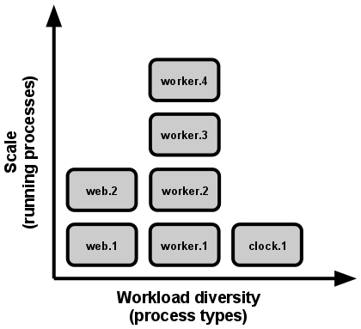
8
Concurrency
Scale out via the process model
www.viettel.com.vn
Notes:
You should decompose your app into independent processes based on process types such as background, web, and worker processes. This enables your app to scale up and down based on individual workload requirements. Most cloud-native apps let you scale on demand. You should design the app as multiple distributed processes that are able to independently execute blocks of work and scale out by adding more processes.
The following sections describe some constructs to make it possible for apps to scale. Apps that are built with the principles of disposability and statelessness at their core are well positioned to gain from these constructs of horizontal scaling
The process model truly shines when it comes time to scale out. The share-nothing, horizontally partitionable nature of twelve-factor app processes means that adding more concurrency is a simple and reliable operation. The array of process types and number of processes of each type is known as the process formation.
Twelve-factor app processes should never daemonize or write PID files. Instead, rely on the operating system’s process manager (such as systemd, a distributed process manager on a cloud platform, or a tool like Foreman in development) to manage output streams, respond to crashed processes, and handle user-initiated restarts and shutdowns.

Slide 45
Mutable configuration
Auto restart
Live reload for web apps
Crash-only design ☺
9
Disposability
Maximize robustness
with fast startup
and graceful shutdown
www.viettel.com.vn
Notes:
The twelve-factor app’s processes are disposable, meaning they can be started or stopped at a moment’s notice. This facilitates fast elastic scaling, rapid deployment of code or config changes, and robustness of production deploys.
Processes should strive to minimize startup time. Ideally, a process takes a few seconds from the time the launch command is executed until the process is up and ready to receive requests or jobs. Short startup time provides more agility for the release process and scaling up; and it aids robustness, because the process manager can more easily move processes to new physical machines when warranted.
Processes shut down gracefully when they receive a SIGTERM signal from the process manager. For a web process, graceful shutdown is achieved by ceasing to listen on the service port (thereby refusing any new requests), allowing any current requests to finish, and then exiting. Implicit in this model is that HTTP requests are short (no more than a few seconds), or in the case of long polling, the client should seamlessly attempt to reconnect when the connection is lost.
For a worker process, graceful shutdown is achieved by returning the current job to the work queue. For example, on RabbitMQ the worker can send a NACK; on Beanstalkd, the job is returned to the queue automatically whenever a worker disconnects. Lock-based systems such as Delayed Job need to be sure to release their lock on the job record. Implicit in this model is that all jobs are reentrant, which typically is achieved by wrapping the results in a transaction, or making the operation idempotent.
Processes should also be robust against sudden death, in the case of a failure in the underlying hardware. While this is a much less common occurrence than a graceful shutdown with SIGTERM, it can still happen. A recommended approach is use of a robust queueing backend, such as Beanstalkd, that returns jobs to the queue when clients disconnect or time out. Either way, a twelve-factor app is architected to handle unexpected, non-graceful terminations. Crash-only design takes this concept to its logical conclusion.

Slide 46
Small changes (large → focused small part)
Reduce time gaps (weeks → hours)
CI/CD shining here
Tools: docker, vagrant, ansible, chef, puppet, saltstack
10
Dev/prod parity
Keep development, staging,
and production
as similar as possible
www.viettel.com.vn
Notes:
Keep development, staging, and production as similar as possible
Historically, there have been substantial gaps between development (a developer making live edits to a local deploy of the app) and production (a running deploy of the app accessed by end users). These gaps manifest in three areas:
The time gap: A developer may work on code that takes days, weeks, or even months to go into production.
The personnel gap: Developers write code, ops engineers deploy it.
The tools gap: Developers may be using a stack like Nginx, SQLite, and OS X, while the production deploy uses Apache, MySQL, and Linux.
The twelve-factor app is designed for continuous deployment by keeping the gap between development and production small. Looking at the three gaps described above:
Make the time gap small: a developer may write code and have it deployed hours or even just minutes later.
Make the personnel gap small: developers who wrote code are closely involved in deploying it and watching its behavior in production.
Make the tools gap small: keep development and production as similar as possible.
Summarizing the above into a table:
Traditional app Twelve-factor app
Time between deploys Weeks Hours
Code authors vs code deployers Different people Same people
Dev vs production environments Divergent As similar as possible
Backing services, such as the app’s database, queueing system, or cache, is one area where dev/prod parity is important. Many languages offer libraries which simplify access to the backing service, including adapters to different types of services. Some examples are in the table below.
Type Language Library Adapters
Database Ruby/Rails ActiveRecord MySQL, PostgreSQL, SQLite
Queue Python/Django Celery RabbitMQ, Beanstalkd, Redis
Cache Ruby/Rails ActiveSupport::Cache Memory, filesystem, Memcached
Developers sometimes find great appeal in using a lightweight backing service in their local environments, while a more serious and robust backing service will be used in production. For example, using SQLite locally and PostgreSQL in production; or local process memory for caching in development and Memcached in production.
The twelve-factor developer resists the urge to use different backing services between development and production, even when adapters theoretically abstract away any differences in backing services. Differences between backing services mean that tiny incompatibilities crop up, causing code that worked and passed tests in development or staging to fail in production. These types of errors create friction that disincentivizes continuous deployment. The cost of this friction and the subsequent dampening of continuous deployment is extremely high when considered in aggregate over the lifetime of an application.
Lightweight local services are less compelling than they once were. Modern backing services such as Memcached, PostgreSQL, and RabbitMQ are not difficult to install and run thanks to modern packaging systems, such as Homebrew and apt-get. Alternatively, declarative provisioning tools such as Chef and Puppet combined with light-weight virtual environments such as Docker and Vagrant allow developers to run local environments which closely approximate production environments. The cost of installing and using these systems is low compared to the benefit of dev/prod parity and continuous deployment.
Adapters to different backing services are still useful, because they make porting to new backing services relatively painless. But all deploys of the app (developer environments, staging, production) should be using the same type and version of each of the backing services.

Slide 47
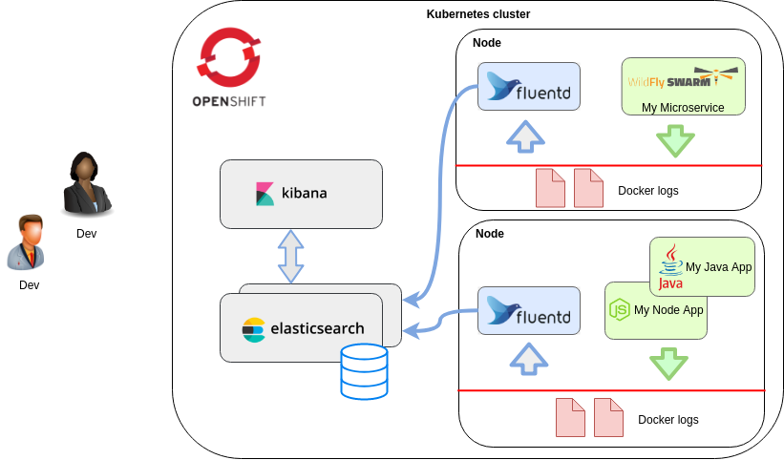
Log file → Stream
Log routers: fluentd, logstash
Log destination: stdout, log file, log storages, elasticsearch
11
Logging
Treat logs as event streams
www.viettel.com.vn
Notes:
Logs provide visibility into the behavior of a running app. In server-based environments they are commonly written to a file on disk (a “logfile”); but this is only an output format.
Logs are the stream of aggregated, time-ordered events collected from the output streams of all running processes and backing services. Logs in their raw form are typically a text format with one event per line (though backtraces from exceptions may span multiple lines). Logs have no fixed beginning or end, but flow continuously as long as the app is operating.
A twelve-factor app never concerns itself with routing or storage of its output stream. It should not attempt to write to or manage logfiles. Instead, each running process writes its event stream, unbuffered, to stdout. During local development, the developer will view this stream in the foreground of their terminal to observe the app’s behavior.
In staging or production deploys, each process’ stream will be captured by the execution environment, collated together with all other streams from the app, and routed to one or more final destinations for viewing and long-term archival. These archival destinations are not visible to or configurable by the app, and instead are completely managed by the execution environment. Open-source log routers (such as Logplex and Fluentd) are available for this purpose.
The event stream for an app can be routed to a file, or watched via realtime tail in a terminal. Most significantly, the stream can be sent to a log indexing and analysis system such as Splunk, or a general-purpose data warehousing system such as Hadoop/Hive. These systems allow for great power and flexibility for introspecting an app’s behavior over time, including:
Finding specific events in the past.
Large-scale graphing of trends (such as requests per minute).
Active alerting according to user-defined heuristics (such as an alert when the quantity of errors per minute exceeds a certain threshold).

Slide 48
Types: db migration, console, commit script
Migration: Flyway, Liquibase, alembic, Django ORM
Run in identical env, same on any release
Ship with app code to avoid synchronization issues
12
Admin process
Run admin/management tasks as one-off processes
www.viettel.com.vn
Notes:
Logs provide visibility into the behavior of a running app. In server-based environments they are commonly written to a file on disk (a “logfile”); but this is only an output format.
Logs are the stream of aggregated, time-ordered events collected from the output streams of all running processes and backing services. Logs in their raw form are typically a text format with one event per line (though backtraces from exceptions may span multiple lines). Logs have no fixed beginning or end, but flow continuously as long as the app is operating.
A twelve-factor app never concerns itself with routing or storage of its output stream. It should not attempt to write to or manage logfiles. Instead, each running process writes its event stream, unbuffered, to stdout. During local development, the developer will view this stream in the foreground of their terminal to observe the app’s behavior.
In staging or production deploys, each process’ stream will be captured by the execution environment, collated together with all other streams from the app, and routed to one or more final destinations for viewing and long-term archival. These archival destinations are not visible to or configurable by the app, and instead are completely managed by the execution environment. Open-source log routers (such as Logplex and Fluentd) are available for this purpose.
The event stream for an app can be routed to a file, or watched via realtime tail in a terminal. Most significantly, the stream can be sent to a log indexing and analysis system such as Splunk, or a general-purpose data warehousing system such as Hadoop/Hive. These systems allow for great power and flexibility for introspecting an app’s behavior over time, including:
Finding specific events in the past.
Large-scale graphing of trends (such as requests per minute).
Active alerting according to user-defined heuristics (such as an alert when the quantity of errors per minute exceeds a certain threshold).

Slide 49
Continuous Integration
Continuous Delivery
CI/CD Tools And Systems
CI/CD
www.viettel.com.vn

Slide 50
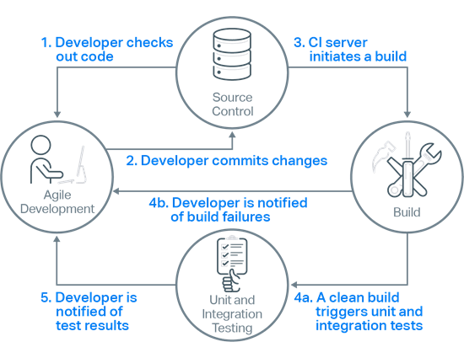
Continuous Integration Definition
“Continuous Integration (CI) is a software development practice where members of a team integrate their work frequently, usually each person integrates at least daily - leading to multiple integrations per day. Each integration is verified by an automated build (including test) to detect integration errors as quickly as possible. Many teams find that this approach leads to significantly reduced integration problems and allows a team to develop cohesive software more rapidly”
Martin Fowler
www.viettel.com.vn
Notes:
Define services corresponding to Domain-Driven Design (DDD) subdomains. DDD refers to the application’s problem space - the business - as the domain. A domain is consists of multiple subdomains. Each subdomain corresponds to a different part of the business.
Subdomains can be classified as follows:
Core - key differentiator for the business and the most valuable part of the application
Supporting - related to what the business does but not a differentiator. These can be implemented in-house or outsourced.
Generic - not specific to the business and are ideally implemented using off the shelf software
Examples
The subdomains of an online store include:
Product catalog
Inventory management
Order management
Delivery management
…
The corresponding microservice architecture would have services corresponding to each of these subdomains
This pattern has the following benefits:
Stable architecture since the subdomains are relatively stable
Development teams are cross-functional, autonomous, and organized around delivering business value rather than technical features
Services are cohesive and loosely coupled
Issues
There are the following issues to address:
How to identify the subdomains? Identifying subdomains and hence services requires an understanding of the business. Like business capabilities, subdomains are identified by analyzing the business and its organizational structure and identifying the different areas of expertise. Subdomains are best identified using an iterative process. Good starting points for identifying subdomains are:
organization structure - different groups within an organization might correspond to subdomains
high-level domain model - subdomains often have a key domain object

Slide 51
CI Benefits
Avoid “integration hell”
Fast feedback loops
Detect and fix issues early
Improve quality and testability
www.viettel.com.vn
Notes:
Fast feedback loop. In software development, what you don’t know really can hurt you. If there’s anything that really slows you down when developing software, it’s the lack of feedback on the quality and impact of the changes you made. You might think you move fast if you quickly commit code and move on to another task without running any tests or sanity checks. The reality will hit you later when you’re trying to figure out which change and from when (and by whom…) broke something. Continuous integration tools — when properly used — will remove much of this headache by providing you with quick answers to the question “did I break something?” for each commit.
Increase transparency and visibility. When your CI/CD pipeline is set up, your entire team will know what’s going on with the builds as well as get the latest results of tests, which means they can raise issues and plan their work in context. You can see which changes tend to break builds more often.
Avoid “integration hell”. If you think of software as a set of Lego pieces, each of which is crafted by an individual developer separately, it becomes clear that making different pieces go “click!” without any effort and friction is what helps the team make progress every day. If a specific piece is fine on its own in terms of implemented code, you will still need to make sure it plays nice with everything else. Continuous integration supports connecting the pieces of your software every day.
Detect and fix issues early. The thing with bugs in software is that they hide other bugs that hide other bugs that… yes, you guessed it, hide more bugs. The more bugs pile up, the harder it is to test and find them, resulting in nasty last minute surprises (especially on a Friday night). If various kinds of useful automated tests are run in your continuous integration pipeline, you’ll be able to know what to fix as soon as a test fails. Not all of the testing can be automated and it takes time to automate what can be automated, but doing so helps you develop software in a sustainable way and keep the technical debt at a minimum.
Improve quality and testability. The easier it is to test something, the easier it is to determine its quality. Testability has multiple dimensions. On the inside, testability can be characterized by how controllable, observable, unbuggy, and decomposable your product is. Simply put, if your code is written in a way that doesn’t accommodate writing tests for it, you will have a hard time making it unbuggy. On the outside, testability is affected by how easily new builds are available, what kind of tools you have, and how much control you have over your test environments. Continuous integration and delivery drive both since you will need to write tests and run them, and also deliver builds frequently and reliably.

Slide 52
CI Techniques
Maintain a Single Source Repository
Small Batches of code in a integration
Automate the Build & Test
Make Your Build Self-Testing
Every Commit Should Build the Mainline on an Integration Machine
Fix Broken Builds Immediately
Keep the Build & Test Fast
Test in a Clone of the Production Environment
Everyone can see what's happening

Slide 53
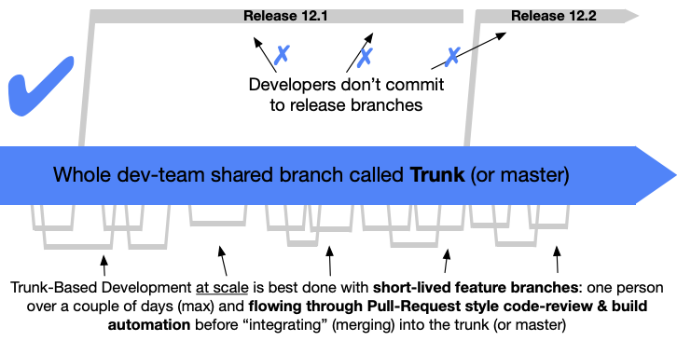
CI Methodologies - Trunk Based Development

Slide 54
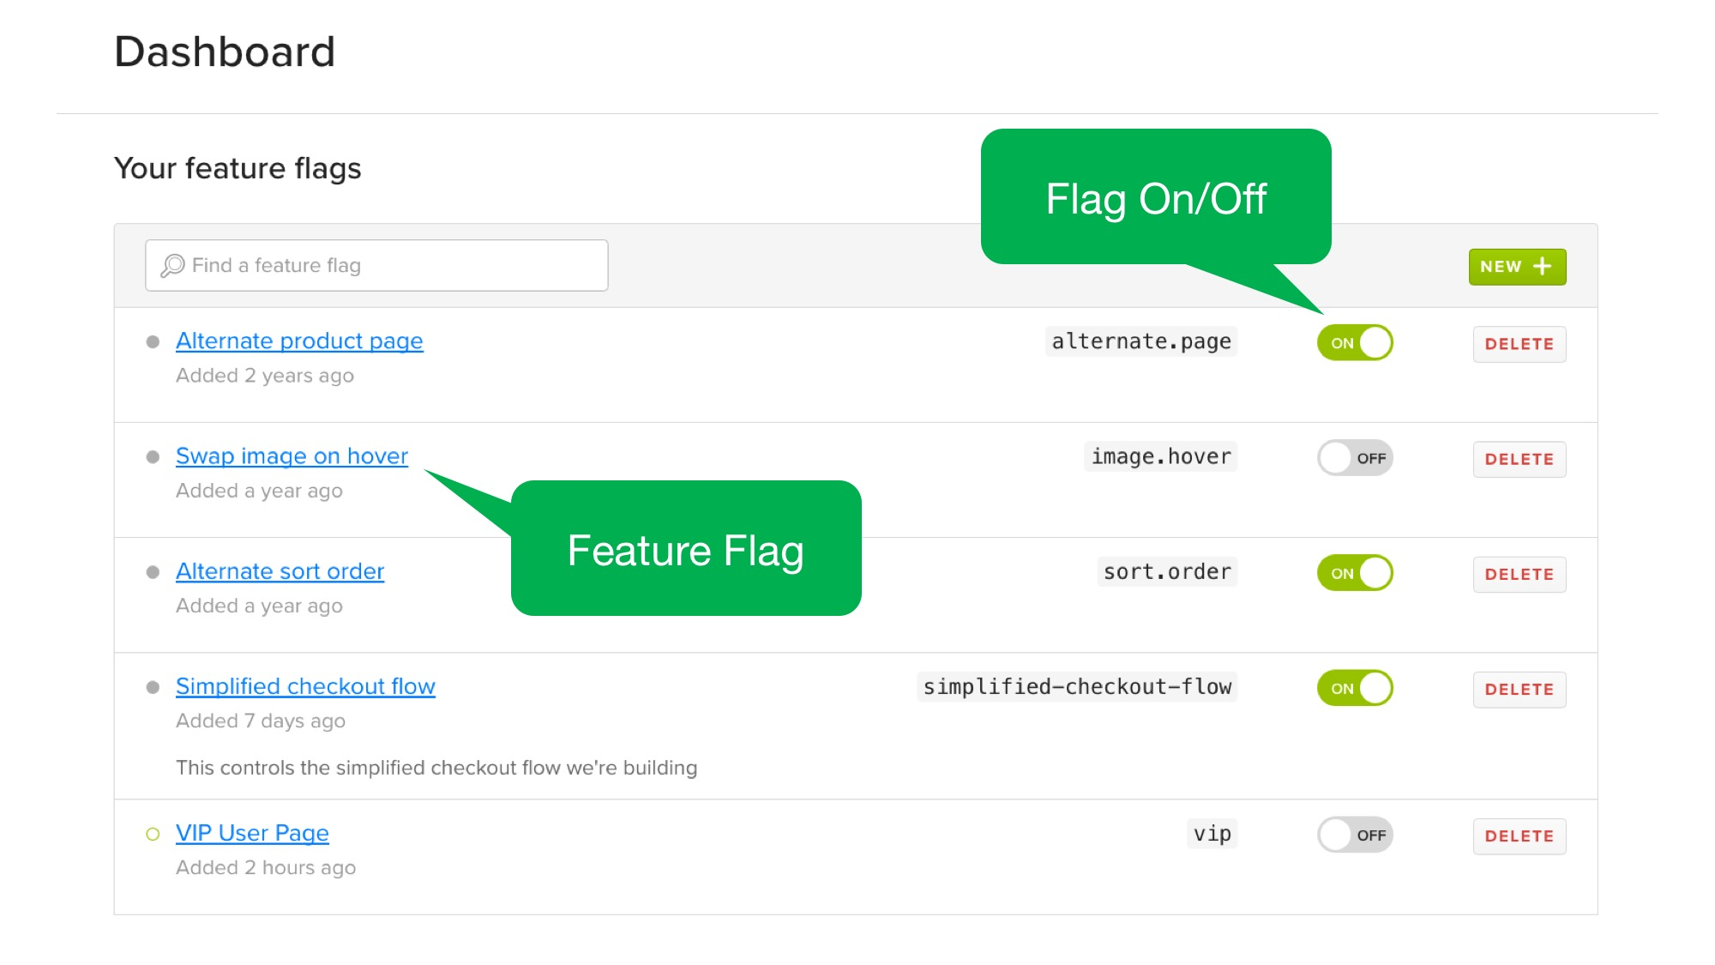
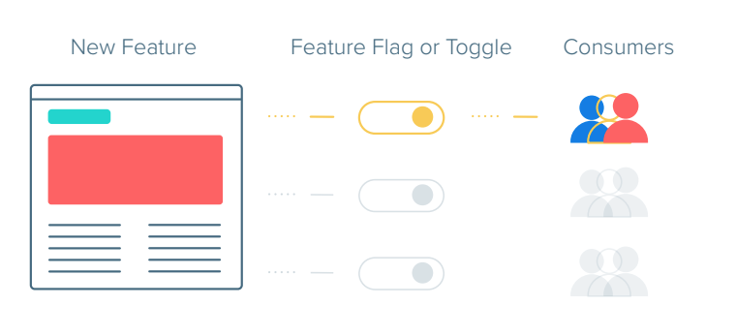
CI Methodologies - Feature Flags

Slide 55
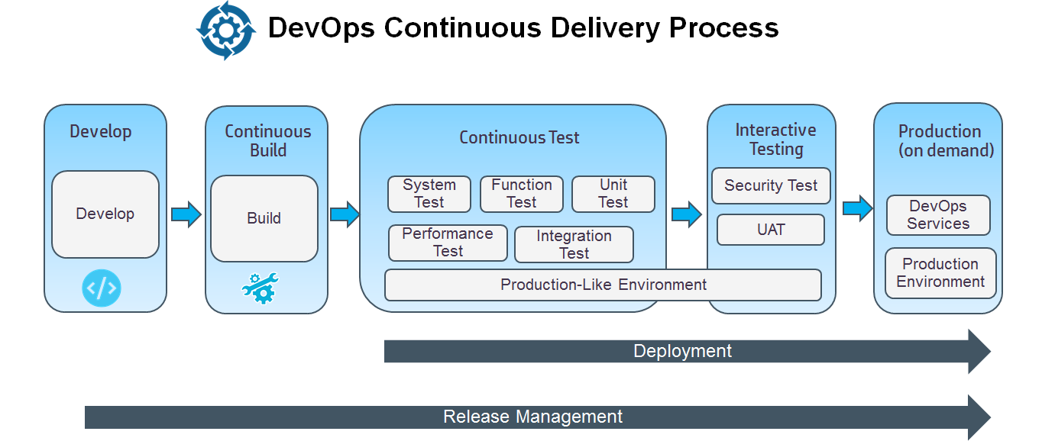
Continuous Delivery Definition
“Continuous Delivery is the ability to get changes of all types—including new features, configuration changes, bug fixes and experiments—into production, or into the hands of users, safely and quickly in a sustainable way.”
https://continuousdelivery.com/
www.viettel.com.vn
Notes:
Define services corresponding to Domain-Driven Design (DDD) subdomains. DDD refers to the application’s problem space - the business - as the domain. A domain is consists of multiple subdomains. Each subdomain corresponds to a different part of the business.
Subdomains can be classified as follows:
Core - key differentiator for the business and the most valuable part of the application
Supporting - related to what the business does but not a differentiator. These can be implemented in-house or outsourced.
Generic - not specific to the business and are ideally implemented using off the shelf software
Examples
The subdomains of an online store include:
Product catalog
Inventory management
Order management
Delivery management
…
The corresponding microservice architecture would have services corresponding to each of these subdomains
This pattern has the following benefits:
Stable architecture since the subdomains are relatively stable
Development teams are cross-functional, autonomous, and organized around delivering business value rather than technical features
Services are cohesive and loosely coupled
Issues
There are the following issues to address:
How to identify the subdomains? Identifying subdomains and hence services requires an understanding of the business. Like business capabilities, subdomains are identified by analyzing the business and its organizational structure and identifying the different areas of expertise. Subdomains are best identified using an iterative process. Good starting points for identifying subdomains are:
organization structure - different groups within an organization might correspond to subdomains
high-level domain model - subdomains often have a key domain object

Slide 56
Continuous Delivery Benefits
Ensures that every change to the system is releasable
Lowers risk of each release - makes releases “boring”
Delivers value more frequently
Get fast feedback on what users care about
www.viettel.com.vn
Notes:
Define services corresponding to Domain-Driven Design (DDD) subdomains. DDD refers to the application’s problem space - the business - as the domain. A domain is consists of multiple subdomains. Each subdomain corresponds to a different part of the business.
Subdomains can be classified as follows:
Core - key differentiator for the business and the most valuable part of the application
Supporting - related to what the business does but not a differentiator. These can be implemented in-house or outsourced.
Generic - not specific to the business and are ideally implemented using off the shelf software
Examples
The subdomains of an online store include:
Product catalog
Inventory management
Order management
Delivery management
…
The corresponding microservice architecture would have services corresponding to each of these subdomains
This pattern has the following benefits:
Stable architecture since the subdomains are relatively stable
Development teams are cross-functional, autonomous, and organized around delivering business value rather than technical features
Services are cohesive and loosely coupled
Issues
There are the following issues to address:
How to identify the subdomains? Identifying subdomains and hence services requires an understanding of the business. Like business capabilities, subdomains are identified by analyzing the business and its organizational structure and identifying the different areas of expertise. Subdomains are best identified using an iterative process. Good starting points for identifying subdomains are:
organization structure - different groups within an organization might correspond to subdomains
high-level domain model - subdomains often have a key domain object

Slide 57
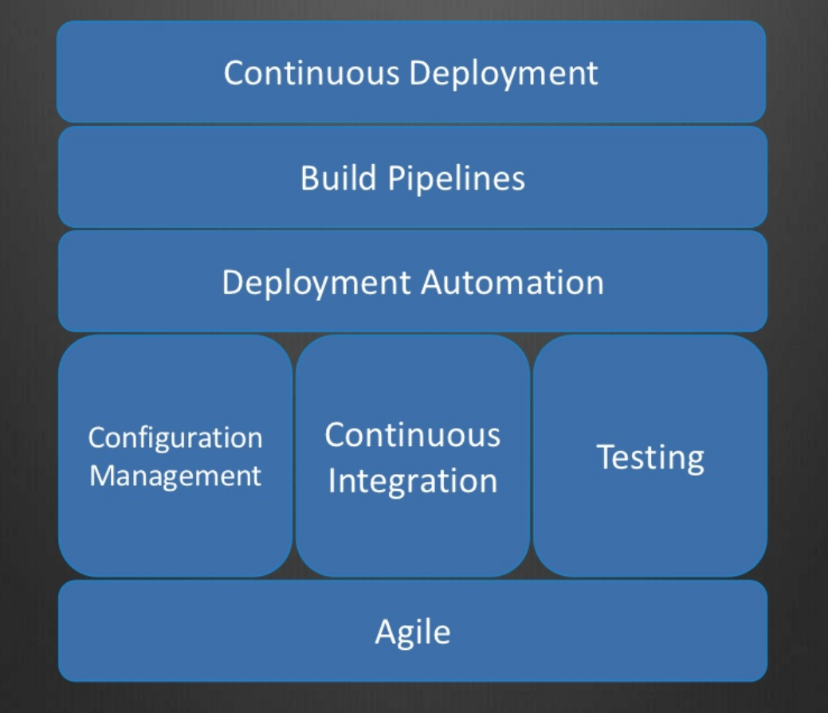
Continuous Delivery Practices
www.viettel.com.vn
Notes:
Define services corresponding to Domain-Driven Design (DDD) subdomains. DDD refers to the application’s problem space - the business - as the domain. A domain is consists of multiple subdomains. Each subdomain corresponds to a different part of the business.
Subdomains can be classified as follows:
Core - key differentiator for the business and the most valuable part of the application
Supporting - related to what the business does but not a differentiator. These can be implemented in-house or outsourced.
Generic - not specific to the business and are ideally implemented using off the shelf software
Examples
The subdomains of an online store include:
Product catalog
Inventory management
Order management
Delivery management
…
The corresponding microservice architecture would have services corresponding to each of these subdomains
This pattern has the following benefits:
Stable architecture since the subdomains are relatively stable
Development teams are cross-functional, autonomous, and organized around delivering business value rather than technical features
Services are cohesive and loosely coupled
Issues
There are the following issues to address:
How to identify the subdomains? Identifying subdomains and hence services requires an understanding of the business. Like business capabilities, subdomains are identified by analyzing the business and its organizational structure and identifying the different areas of expertise. Subdomains are best identified using an iterative process. Good starting points for identifying subdomains are:
organization structure - different groups within an organization might correspond to subdomains
high-level domain model - subdomains often have a key domain object

Slide 58
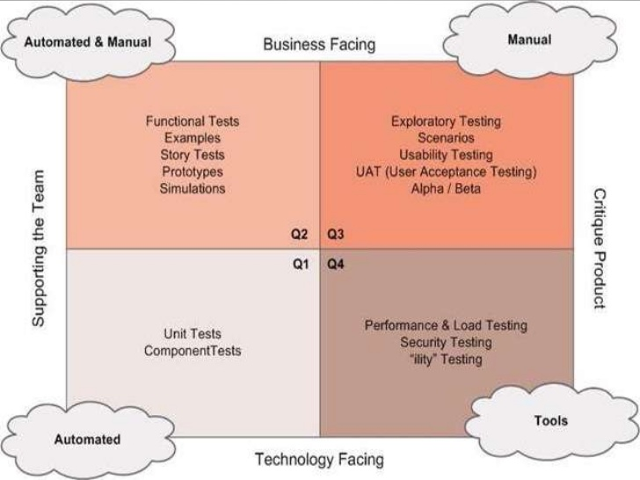
Continuous Delivery Practices
www.viettel.com.vn
Notes:
Define services corresponding to Domain-Driven Design (DDD) subdomains. DDD refers to the application’s problem space - the business - as the domain. A domain is consists of multiple subdomains. Each subdomain corresponds to a different part of the business.
Subdomains can be classified as follows:
Core - key differentiator for the business and the most valuable part of the application
Supporting - related to what the business does but not a differentiator. These can be implemented in-house or outsourced.
Generic - not specific to the business and are ideally implemented using off the shelf software
Examples
The subdomains of an online store include:
Product catalog
Inventory management
Order management
Delivery management
…
The corresponding microservice architecture would have services corresponding to each of these subdomains
This pattern has the following benefits:
Stable architecture since the subdomains are relatively stable
Development teams are cross-functional, autonomous, and organized around delivering business value rather than technical features
Services are cohesive and loosely coupled
Issues
There are the following issues to address:
How to identify the subdomains? Identifying subdomains and hence services requires an understanding of the business. Like business capabilities, subdomains are identified by analyzing the business and its organizational structure and identifying the different areas of expertise. Subdomains are best identified using an iterative process. Good starting points for identifying subdomains are:
organization structure - different groups within an organization might correspond to subdomains
high-level domain model - subdomains often have a key domain object

Slide 59




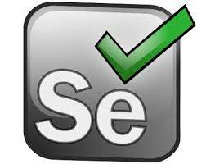

CI/CD Tools & System
Automation testing tools
Unit Test
Component Test
Performance Test
Acceptance Test
UI Test
...
Automation code analysis tool

Slide 60



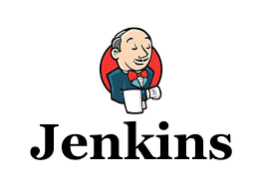


CI/CD Tools & System
Source Version Control System
Packaging Tool
Application Repository
Integration System
Orchestration System

Slide 61
Monitoring & Observability
www.viettel.com.vn

Slide 62
What is Observability?
There is no “real” definition for Observability
The ability to understand what is happening inside of a system from the knowledge of its external outputs - Dynatrace
“We use it to describe the tools, data sources, and methods for understanding (observing!) how a technology is operating” - Brendan Gregg
www.viettel.com.vn
Notes:
Define services corresponding to Domain-Driven Design (DDD) subdomains. DDD refers to the application’s problem space - the business - as the domain. A domain is consists of multiple subdomains. Each subdomain corresponds to a different part of the business.
Subdomains can be classified as follows:
Core - key differentiator for the business and the most valuable part of the application
Supporting - related to what the business does but not a differentiator. These can be implemented in-house or outsourced.
Generic - not specific to the business and are ideally implemented using off the shelf software
Examples
The subdomains of an online store include:
Product catalog
Inventory management
Order management
Delivery management
…
The corresponding microservice architecture would have services corresponding to each of these subdomains
This pattern has the following benefits:
Stable architecture since the subdomains are relatively stable
Development teams are cross-functional, autonomous, and organized around delivering business value rather than technical features
Services are cohesive and loosely coupled
Issues
There are the following issues to address:
How to identify the subdomains? Identifying subdomains and hence services requires an understanding of the business. Like business capabilities, subdomains are identified by analyzing the business and its organizational structure and identifying the different areas of expertise. Subdomains are best identified using an iterative process. Good starting points for identifying subdomains are:
organization structure - different groups within an organization might correspond to subdomains
high-level domain model - subdomains often have a key domain object

Slide 63
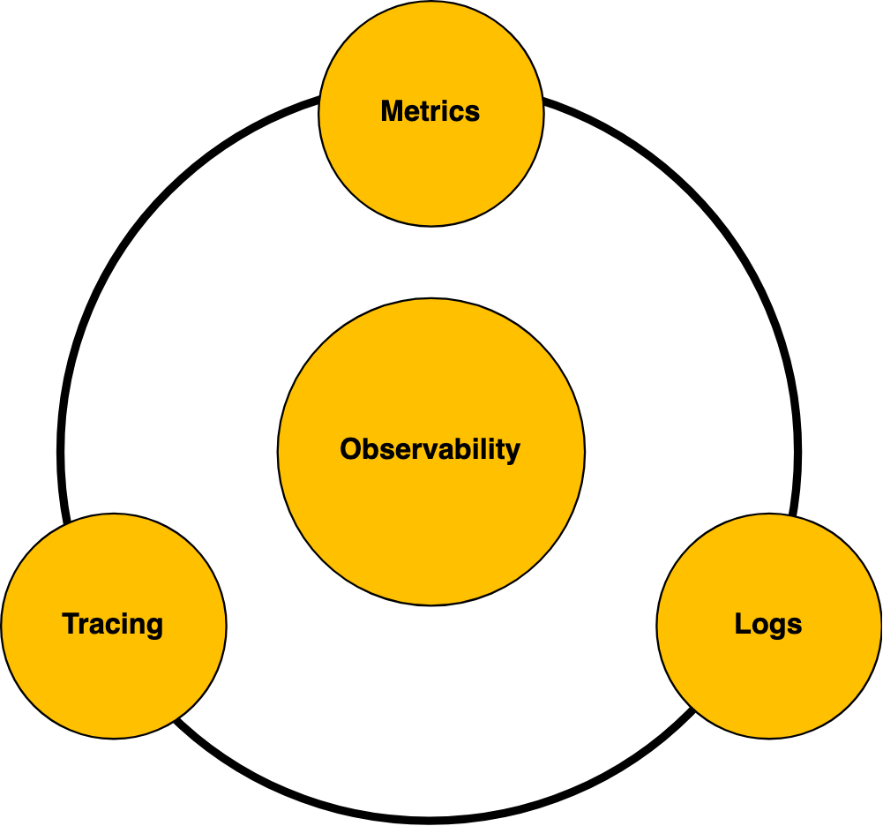
What is Observability?
for distributed systems, such as microservices, serverless, service meshes, etc., these outputs are telemetry data
www.viettel.com.vn
Notes:
Define services corresponding to Domain-Driven Design (DDD) subdomains. DDD refers to the application’s problem space - the business - as the domain. A domain is consists of multiple subdomains. Each subdomain corresponds to a different part of the business.
Subdomains can be classified as follows:
Core - key differentiator for the business and the most valuable part of the application
Supporting - related to what the business does but not a differentiator. These can be implemented in-house or outsourced.
Generic - not specific to the business and are ideally implemented using off the shelf software
Examples
The subdomains of an online store include:
Product catalog
Inventory management
Order management
Delivery management
…
The corresponding microservice architecture would have services corresponding to each of these subdomains
This pattern has the following benefits:
Stable architecture since the subdomains are relatively stable
Development teams are cross-functional, autonomous, and organized around delivering business value rather than technical features
Services are cohesive and loosely coupled
Issues
There are the following issues to address:
How to identify the subdomains? Identifying subdomains and hence services requires an understanding of the business. Like business capabilities, subdomains are identified by analyzing the business and its organizational structure and identifying the different areas of expertise. Subdomains are best identified using an iterative process. Good starting points for identifying subdomains are:
organization structure - different groups within an organization might correspond to subdomains
high-level domain model - subdomains often have a key domain object

Slide 64
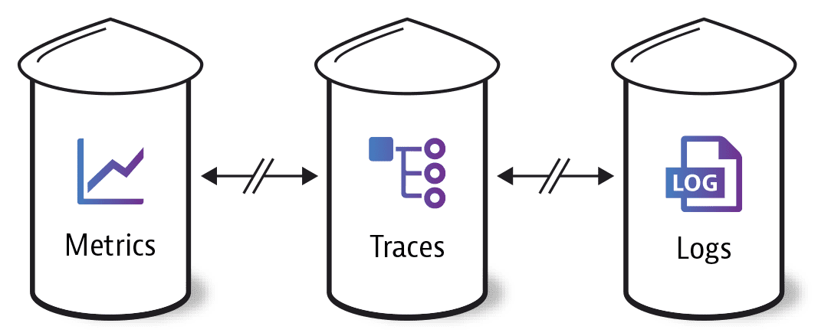
Three pillars of Telemetry
Telemetry data is divided into three major verticals – metrics, logs, and distributed traces
Source: Dynatrace
www.viettel.com.vn
Notes:
Define services corresponding to Domain-Driven Design (DDD) subdomains. DDD refers to the application’s problem space - the business - as the domain. A domain is consists of multiple subdomains. Each subdomain corresponds to a different part of the business.
Subdomains can be classified as follows:
Core - key differentiator for the business and the most valuable part of the application
Supporting - related to what the business does but not a differentiator. These can be implemented in-house or outsourced.
Generic - not specific to the business and are ideally implemented using off the shelf software
Examples
The subdomains of an online store include:
Product catalog
Inventory management
Order management
Delivery management
…
The corresponding microservice architecture would have services corresponding to each of these subdomains
This pattern has the following benefits:
Stable architecture since the subdomains are relatively stable
Development teams are cross-functional, autonomous, and organized around delivering business value rather than technical features
Services are cohesive and loosely coupled
Issues
There are the following issues to address:
How to identify the subdomains? Identifying subdomains and hence services requires an understanding of the business. Like business capabilities, subdomains are identified by analyzing the business and its organizational structure and identifying the different areas of expertise. Subdomains are best identified using an iterative process. Good starting points for identifying subdomains are:
organization structure - different groups within an organization might correspond to subdomains
high-level domain model - subdomains often have a key domain object

Slide 65
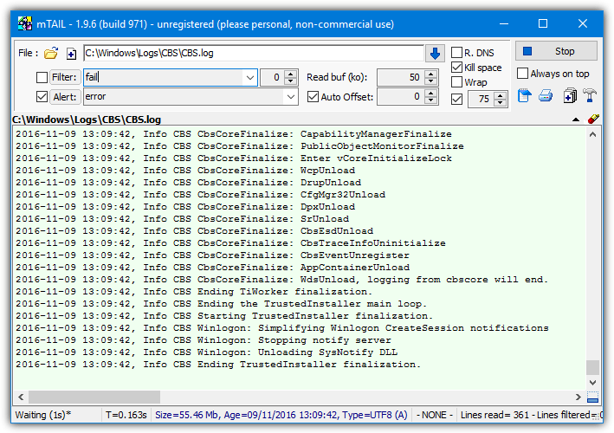
Logs
an event log is an immutable, timestamped record of discrete events that happened over time
easiest to generate (printf, echo)
no external tools required
human readable
UNIX-style
can affect application performance as a whole
system scoped
www.viettel.com.vn
Notes:
Define services corresponding to Domain-Driven Design (DDD) subdomains. DDD refers to the application’s problem space - the business - as the domain. A domain is consists of multiple subdomains. Each subdomain corresponds to a different part of the business.
Subdomains can be classified as follows:
Core - key differentiator for the business and the most valuable part of the application
Supporting - related to what the business does but not a differentiator. These can be implemented in-house or outsourced.
Generic - not specific to the business and are ideally implemented using off the shelf software
Examples
The subdomains of an online store include:
Product catalog
Inventory management
Order management
Delivery management
…
The corresponding microservice architecture would have services corresponding to each of these subdomains
This pattern has the following benefits:
Stable architecture since the subdomains are relatively stable
Development teams are cross-functional, autonomous, and organized around delivering business value rather than technical features
Services are cohesive and loosely coupled
Issues
There are the following issues to address:
How to identify the subdomains? Identifying subdomains and hence services requires an understanding of the business. Like business capabilities, subdomains are identified by analyzing the business and its organizational structure and identifying the different areas of expertise. Subdomains are best identified using an iterative process. Good starting points for identifying subdomains are:
organization structure - different groups within an organization might correspond to subdomains
high-level domain model - subdomains often have a key domain object

Slide 66
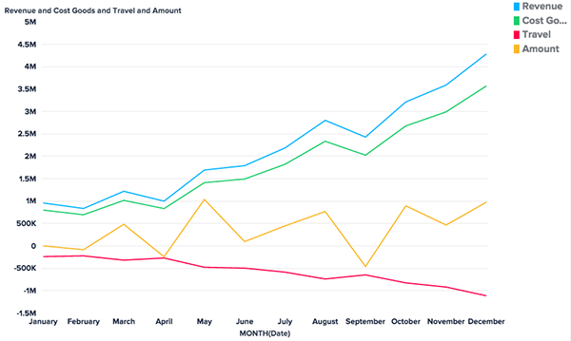
Metrics
metrics are a numeric representation of data measured over intervals of time
minimal store size
low performance impact
easier to query
overheads are predictable
suitable for triggering alerts
system scoped
www.viettel.com.vn
Notes:
Define services corresponding to Domain-Driven Design (DDD) subdomains. DDD refers to the application’s problem space - the business - as the domain. A domain is consists of multiple subdomains. Each subdomain corresponds to a different part of the business.
Subdomains can be classified as follows:
Core - key differentiator for the business and the most valuable part of the application
Supporting - related to what the business does but not a differentiator. These can be implemented in-house or outsourced.
Generic - not specific to the business and are ideally implemented using off the shelf software
Examples
The subdomains of an online store include:
Product catalog
Inventory management
Order management
Delivery management
…
The corresponding microservice architecture would have services corresponding to each of these subdomains
This pattern has the following benefits:
Stable architecture since the subdomains are relatively stable
Development teams are cross-functional, autonomous, and organized around delivering business value rather than technical features
Services are cohesive and loosely coupled
Issues
There are the following issues to address:
How to identify the subdomains? Identifying subdomains and hence services requires an understanding of the business. Like business capabilities, subdomains are identified by analyzing the business and its organizational structure and identifying the different areas of expertise. Subdomains are best identified using an iterative process. Good starting points for identifying subdomains are:
organization structure - different groups within an organization might correspond to subdomains
high-level domain model - subdomains often have a key domain object

Slide 67
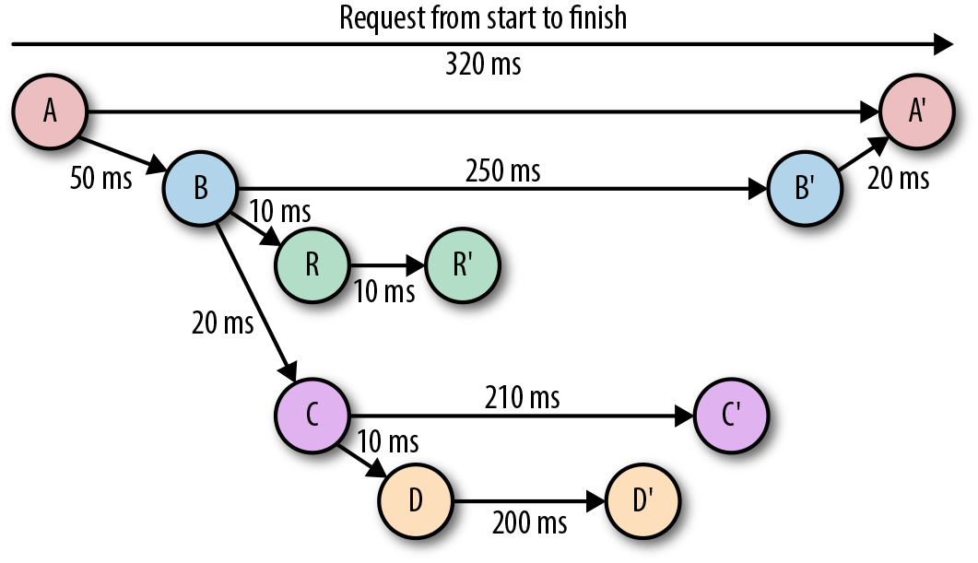
Tracing
a trace is a representation of a series of causally related distributed events that encode the end-to-end request flow through a distributed system
a representation of logs
an understanding of the entire request lifecycle
inter service dependency analysis
distributed profiling
debugging steady-state problems
everything requires additional instrumentation
www.viettel.com.vn
Notes:
Define services corresponding to Domain-Driven Design (DDD) subdomains. DDD refers to the application’s problem space - the business - as the domain. A domain is consists of multiple subdomains. Each subdomain corresponds to a different part of the business.
Subdomains can be classified as follows:
Core - key differentiator for the business and the most valuable part of the application
Supporting - related to what the business does but not a differentiator. These can be implemented in-house or outsourced.
Generic - not specific to the business and are ideally implemented using off the shelf software
Examples
The subdomains of an online store include:
Product catalog
Inventory management
Order management
Delivery management
…
The corresponding microservice architecture would have services corresponding to each of these subdomains
This pattern has the following benefits:
Stable architecture since the subdomains are relatively stable
Development teams are cross-functional, autonomous, and organized around delivering business value rather than technical features
Services are cohesive and loosely coupled
Issues
There are the following issues to address:
How to identify the subdomains? Identifying subdomains and hence services requires an understanding of the business. Like business capabilities, subdomains are identified by analyzing the business and its organizational structure and identifying the different areas of expertise. Subdomains are best identified using an iterative process. Good starting points for identifying subdomains are:
organization structure - different groups within an organization might correspond to subdomains
high-level domain model - subdomains often have a key domain object

Slide 68
Why Observability?
there are two overarching problems worth solving with Observability for modern, distributed software applications:
Understanding Health
Understanding Change
www.viettel.com.vn
Notes:
Define services corresponding to Domain-Driven Design (DDD) subdomains. DDD refers to the application’s problem space - the business - as the domain. A domain is consists of multiple subdomains. Each subdomain corresponds to a different part of the business.
Subdomains can be classified as follows:
Core - key differentiator for the business and the most valuable part of the application
Supporting - related to what the business does but not a differentiator. These can be implemented in-house or outsourced.
Generic - not specific to the business and are ideally implemented using off the shelf software
Examples
The subdomains of an online store include:
Product catalog
Inventory management
Order management
Delivery management
…
The corresponding microservice architecture would have services corresponding to each of these subdomains
This pattern has the following benefits:
Stable architecture since the subdomains are relatively stable
Development teams are cross-functional, autonomous, and organized around delivering business value rather than technical features
Services are cohesive and loosely coupled
Issues
There are the following issues to address:
How to identify the subdomains? Identifying subdomains and hence services requires an understanding of the business. Like business capabilities, subdomains are identified by analyzing the business and its organizational structure and identifying the different areas of expertise. Subdomains are best identified using an iterative process. Good starting points for identifying subdomains are:
organization structure - different groups within an organization might correspond to subdomains
high-level domain model - subdomains often have a key domain object

Slide 69
Understand Health
Connecting the well-being of a subsystem back to the goals of the overarching application and business via thoughtful monitoring
www.viettel.com.vn
Notes:
Define services corresponding to Domain-Driven Design (DDD) subdomains. DDD refers to the application’s problem space - the business - as the domain. A domain is consists of multiple subdomains. Each subdomain corresponds to a different part of the business.
Subdomains can be classified as follows:
Core - key differentiator for the business and the most valuable part of the application
Supporting - related to what the business does but not a differentiator. These can be implemented in-house or outsourced.
Generic - not specific to the business and are ideally implemented using off the shelf software
Examples
The subdomains of an online store include:
Product catalog
Inventory management
Order management
Delivery management
…
The corresponding microservice architecture would have services corresponding to each of these subdomains
This pattern has the following benefits:
Stable architecture since the subdomains are relatively stable
Development teams are cross-functional, autonomous, and organized around delivering business value rather than technical features
Services are cohesive and loosely coupled
Issues
There are the following issues to address:
How to identify the subdomains? Identifying subdomains and hence services requires an understanding of the business. Like business capabilities, subdomains are identified by analyzing the business and its organizational structure and identifying the different areas of expertise. Subdomains are best identified using an iterative process. Good starting points for identifying subdomains are:
organization structure - different groups within an organization might correspond to subdomains
high-level domain model - subdomains often have a key domain object

Slide 70

Understand Change
Accelerating planned changes while mitigating the effects of unplanned changes
Source: thenewstack
www.viettel.com.vn
Notes:
Define services corresponding to Domain-Driven Design (DDD) subdomains. DDD refers to the application’s problem space - the business - as the domain. A domain is consists of multiple subdomains. Each subdomain corresponds to a different part of the business.
Subdomains can be classified as follows:
Core - key differentiator for the business and the most valuable part of the application
Supporting - related to what the business does but not a differentiator. These can be implemented in-house or outsourced.
Generic - not specific to the business and are ideally implemented using off the shelf software
Examples
The subdomains of an online store include:
Product catalog
Inventory management
Order management
Delivery management
…
The corresponding microservice architecture would have services corresponding to each of these subdomains
This pattern has the following benefits:
Stable architecture since the subdomains are relatively stable
Development teams are cross-functional, autonomous, and organized around delivering business value rather than technical features
Services are cohesive and loosely coupled
Issues
There are the following issues to address:
How to identify the subdomains? Identifying subdomains and hence services requires an understanding of the business. Like business capabilities, subdomains are identified by analyzing the business and its organizational structure and identifying the different areas of expertise. Subdomains are best identified using an iterative process. Good starting points for identifying subdomains are:
organization structure - different groups within an organization might correspond to subdomains
high-level domain model - subdomains often have a key domain object

Slide 71
Microservices Architecture
Cloud-Native Application
CI/CD
Monitoring & Observability
Case Study: Viettel Vsmart
www.viettel.com.vn

Slide 72

Spring Cloud Platform

Slide 73

Microservices Architecture

Slide 74

Deployment Architecture
NOCPRO

Slide 75

Service Instance Architecture

Slide 76




Source Code Management

Slide 77

Release Model

Slide 78

Dependencies Management

Slide 79




Config Management

Slide 80

Build One - Run Everywhere

Slide 81

Auto Scaling In Cloud

Slide 82

Auto Scaling In Cloud

Slide 83

Auto Scaling In Cloud

Slide 84


Auto Scaling In Cloud

Slide 85

CI/CD Automation Pipeline

Slide 86

CI/CD Automation Pipeline

Slide 87

CI/CD Automation Pipeline

Slide 88

CI/CD Pipeline

Slide 89




CI/CD Pipeline

Slide 90


CI/CD Pipeline

Slide 91
Monitoring

Slide 92
Logging

Slide 93

Logging

Slide 94
Tracing

Slide 95
References
https://www.nginx.com/blog/introduction-to-microservices/
https://12factor.net/
https://martinfowler.com/articles/microservices.html
Ebook: Building Microservices - Sam Newman
www.viettel.com.vn
Notes:
Define services corresponding to Domain-Driven Design (DDD) subdomains. DDD refers to the application’s problem space - the business - as the domain. A domain is consists of multiple subdomains. Each subdomain corresponds to a different part of the business.
Subdomains can be classified as follows:
Core - key differentiator for the business and the most valuable part of the application
Supporting - related to what the business does but not a differentiator. These can be implemented in-house or outsourced.
Generic - not specific to the business and are ideally implemented using off the shelf software
Examples
The subdomains of an online store include:
Product catalog
Inventory management
Order management
Delivery management
…
The corresponding microservice architecture would have services corresponding to each of these subdomains
This pattern has the following benefits:
Stable architecture since the subdomains are relatively stable
Development teams are cross-functional, autonomous, and organized around delivering business value rather than technical features
Services are cohesive and loosely coupled
Issues
There are the following issues to address:
How to identify the subdomains? Identifying subdomains and hence services requires an understanding of the business. Like business capabilities, subdomains are identified by analyzing the business and its organizational structure and identifying the different areas of expertise. Subdomains are best identified using an iterative process. Good starting points for identifying subdomains are:
organization structure - different groups within an organization might correspond to subdomains
high-level domain model - subdomains often have a key domain object

Slide 96
Exercise
Practice Jenkins CI example: https://www.jenkins.io/doc/tutorials/build-a-java-app-with-maven/
Write a simple Web Server in a language (Go, Java, Python, Ruby...)
Write some unit tests for above Web Server
Push Code to Repository
Write CI Pipeline in file Jenkinsfile, perform unit test in CI Pipeline
Add Dockerfile and docker-compose.yml to repository
Write CD Pipeline in file Jenkinsfile-CD performs:
Build docker image from Repository
Push docker image to DockerHub
Install ansible plugins to Jenkins: https://plugins.jenkins.io/ansible/
Update CD Pipeline, add deploy stage using ansible deploy web server docker-compose stack to a target host (localhost or VM)
Submit Web Server Source Code, two file Jenkinsfile and Jenkinsfile-CD to week-5 folder, include Jenkins run CI and CD Console Output logs if you have
www.viettel.com.vn
Notes:
Define services corresponding to Domain-Driven Design (DDD) subdomains. DDD refers to the application’s problem space - the business - as the domain. A domain is consists of multiple subdomains. Each subdomain corresponds to a different part of the business.
Subdomains can be classified as follows:
Core - key differentiator for the business and the most valuable part of the application
Supporting - related to what the business does but not a differentiator. These can be implemented in-house or outsourced.
Generic - not specific to the business and are ideally implemented using off the shelf software
Examples
The subdomains of an online store include:
Product catalog
Inventory management
Order management
Delivery management
…
The corresponding microservice architecture would have services corresponding to each of these subdomains
This pattern has the following benefits:
Stable architecture since the subdomains are relatively stable
Development teams are cross-functional, autonomous, and organized around delivering business value rather than technical features
Services are cohesive and loosely coupled
Issues
There are the following issues to address:
How to identify the subdomains? Identifying subdomains and hence services requires an understanding of the business. Like business capabilities, subdomains are identified by analyzing the business and its organizational structure and identifying the different areas of expertise. Subdomains are best identified using an iterative process. Good starting points for identifying subdomains are:
organization structure - different groups within an organization might correspond to subdomains
high-level domain model - subdomains often have a key domain object

Slide 97

THANK YOU
www.viettel.com.vn

Slide 98
BACKUP SLIDES
www.viettel.com.vn

Slide 99
Testing in Microservice
https://martinfowler.com/articles/microservice-testing/#anatomy-modules

Slide 100
Demo CI/CD Pipeline
https://github.com/haminhcong/simple-java-maven-app/blob/master/Jenkinsfile
http://127.0.0.1:8080/

